Slide 1

Terraform

Slide 2
Traditional Way of Managing Infrastructure

Slide 3
Overview of IaC
Overview
In the past, managing IT infrastructure was a hard job. System administrators had to manually manage and configure all of the hardware and software that was needed for the applications to run.
However, in recent years, things have changed dramatically. Trends like cloud computing revolutionized—and improved—the way organizations design, develop, and maintain their IT infrastructure.
One of the critical components of this trend is called “infrastructure as code,”
IaC = Infrastructure as a code which means write the code create you infrastructure instead of manual process.

Slide 4
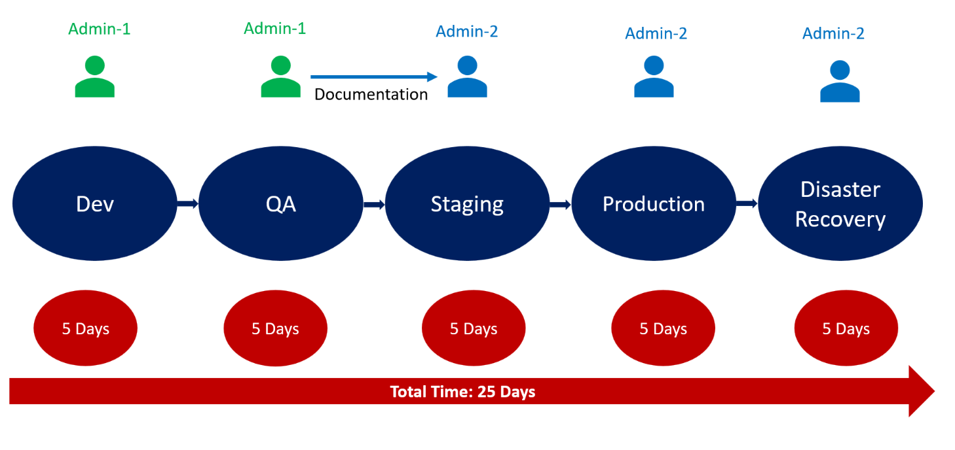
Traditional Way of Managing Infrastructure

Slide 5
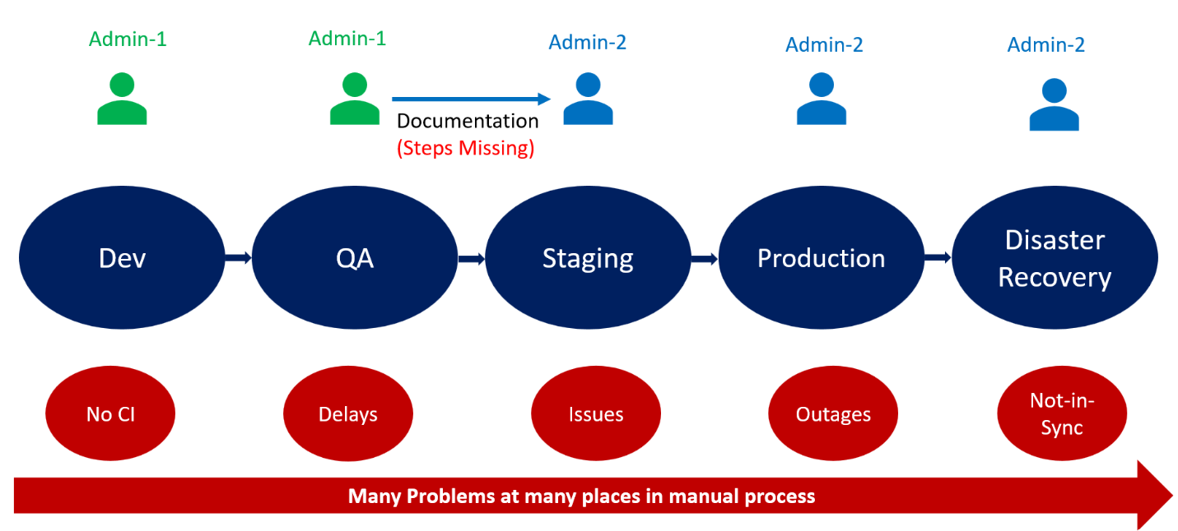
Traditional Way of Managing Infrastructure

Slide 6
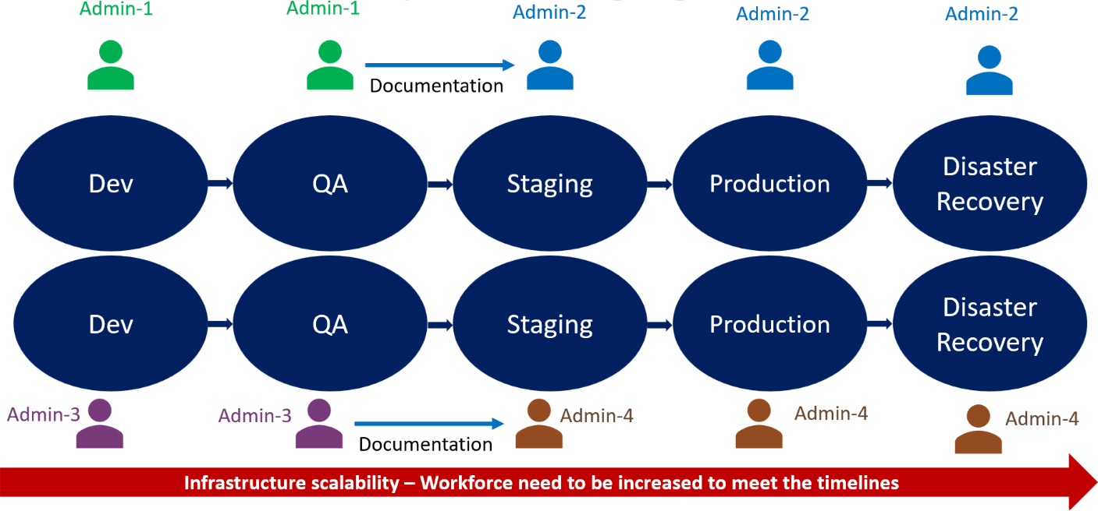
Traditional Way of Managing Infrastructure

Slide 7
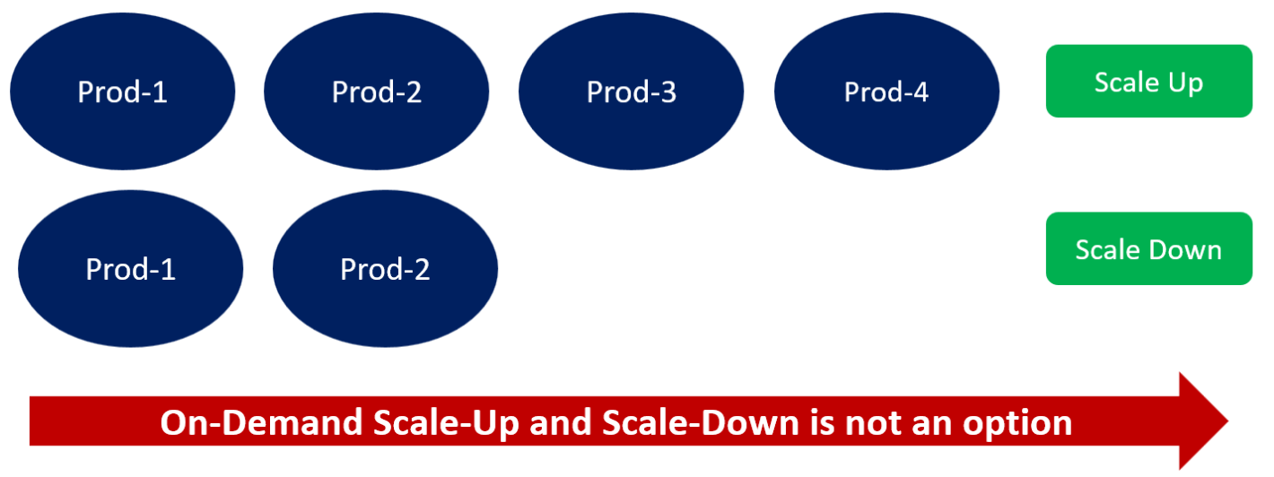
Traditional Way of Managing Infrastructure

Slide 8

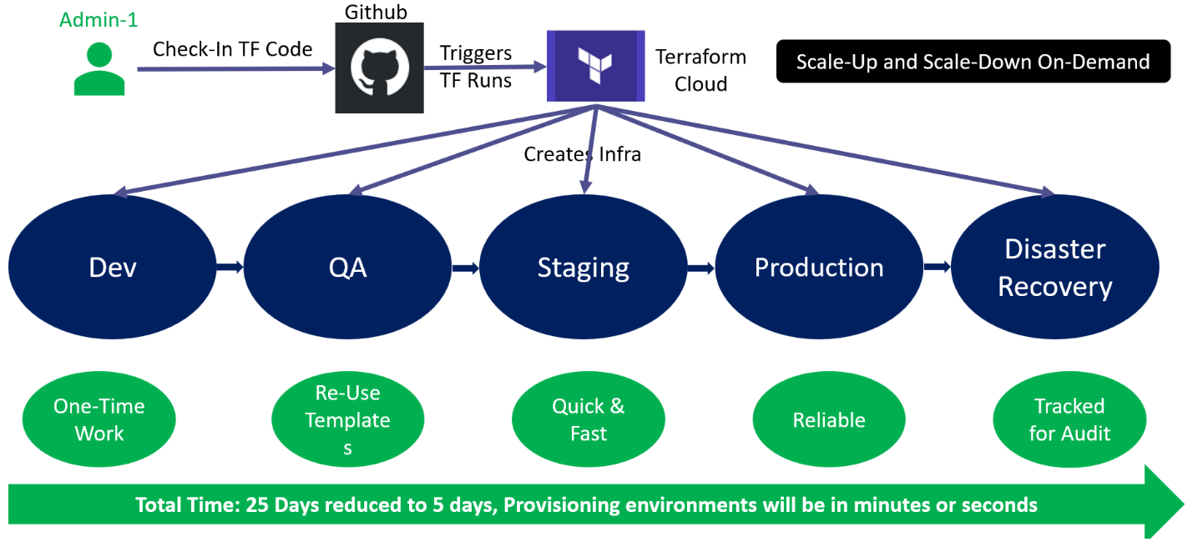
Managing Infrastructure with IaC

Slide 9
Managing your Infrastructure with IaC

Slide 10
What is IaC and it Benefits?

Slide 11
Benefit of Infrastructure as code (IaC)
Infrastructure as Code (IaC) is the managing and provisioning of infrastructure through code instead of through manual processes. Instead of manually configuring cloud nodes or physical hardware, IaC automates the process infrastructure management through source code.
Here are several of the major key benefits of using an IaC solution like Terraform:
Simplicity - IaC eliminates manual processes, thereby accelerating the delivery and management lifecycles. IaC makes it possible to spin up an entire infrastructure architecture by simply running a script.
Team Collaboration - Various team members can collaborate on IaC software in the same way they would with regular application code through tools like Github. Code can be easily linked to issue tracking systems for future use and reference.
Error Reduction - IaC minimizes the probability of errors or deviations when provisioning your infrastructure. The code completely, standardizes your setup, allowing applications to run smoothly and error-free without the constant need for admin oversight.

Slide 12
Benefit of Infrastructure as code (IaC)
Here are several of the major key benefits of using an IaC solution like Terraform:
Disaster Recovery - With IaC you can actually recover from disasters more rapidly. Because manually constructed infrastructure needs to be manually rebuilt. But with IaC, you can usually just re-run scripts and have the exact same software provisioned again or by quickly creating a new, identical environment from the IaC scripts
Enhanced Security - IaC relies on automation that removes many security risks associated with human error. When an IaC-based solution is installed correctly, the overall security of your computing architecture and associated data improves massively (proper credentials management.
Speed - IaC transforms developers’ time-consuming provisioning work into a simple script execution to have their infrastructure ready. As a result, application deployments no longer have to wait for the infrastructure, and new software can be released much more quickly.

Slide 13
Benefit of Infrastructure as code (IaC)
Here are several of the major key benefits of using an IaC solution like Terraform:
Consistency - IaC can improve consistency and reduce errors that often happen during manual configuration. It also eliminates any configuration drift that might occur during a manual process. By codifying and documenting your configuration specifications, IaC helps you avoid undocumented, ad-hoc configuration changes. With IaC, you can create separate but identical (or near-identical) environments (staging, production, test, etc.)
Efficiency: Codifying your infrastructure gives you a template for provisioning, simplifying system configuration, maintenance, and management. It creates an elastic infrastructure that is repeatable and scalable. This means that DevOps can accelerate every step of software development, leading to more applications being released on a daily basis
Reduced cost: IaC allows virtual machines to be managed programmatically, eliminating the need for manual hardware configuration and updates

Slide 14
Benefit of Infrastructure as code (IaC)
Here are several of the major key benefits of using an IaC solution like Terraform:
Visibility - With IaC, we have a very clear reference of what resource we created, and what their settings are. We do not have to navigate to the web console to check the parameters.
Stability - If you accidentally change the wrong setting or delete the wrong resources in the web console, you can break things just with one click because IaC helps solve this issue, especially when it is with version control such as Git.
Scalability - With IaC, we can write it once and then reuse it many times. This means when you write the template, you can use it as many time as you want to deploy multiple environments.

Slide 15
Popular IaC Tools

Slide 16

What is terraform?
Terraform is an IAC tool, used primarily by DevOps teams to automate various infrastructure tasks. The provisioning of cloud resources, for instance, is one of the main use cases of Terraform. It’s an open-source provisioning tool written in the Go language and created by HashiCorp.
Terraform uses HCL language which stand for HashiCorp Configuration Language
Terraform allows you to describe your complete infrastructure in the form of code. Even if your servers come from different providers such as AWS or Azure, Terraform helps you build and manage these resources in parallel across providers

Slide 17
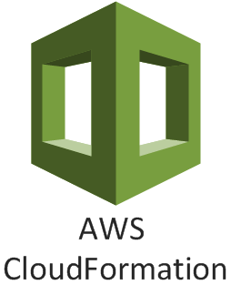
What is AWS CloudFormation?
CloudFormation is an infrastructure service create by AWS. AWS CloudFormation provides users with a simple way to create and manage a collection of Amazon Web Services (AWS) resources by provisioning and updating them in a predictable way. AWS CloudFormation enables you to manage your complete infrastructure or AWS resources in a text file.
JSON / YAML -Templates can be defined using JSON or YAML. It’s generally best practice to use YAML to define these templates for readability and maintainability purposes

Slide 18
Terraform key features
Manage using IaC With Terraform
1. Track your infrastructure
Terraform keeps track of your real infrastructure in a state file, which acts as a source of truth for your environment (desire state). Terraform uses the state file to determine the changes to make to your infrastructure so that it will match your configuration.
2. Collaborate
Terraform allows you to collaborate on your infrastructure with its remote state backends. When you use Terraform Cloud (free for up to five users), you can securely share your state with your teammates, provide a stable environment for Terraform to run in, and prevent race conditions when multiple people make configuration changes at once.
3. State Management
State management is a key component of any long-term Terraform project. The Terraform state file keeps track of all changes in an environment. By default, the state file is stored on the filesystem. However, it is important to keep the state file safe, secure and backed up - which generally means keeping it in highly available object storage. By leveraging this remote storage, teams can safely share and interact with a single state that is always current.

Slide 19
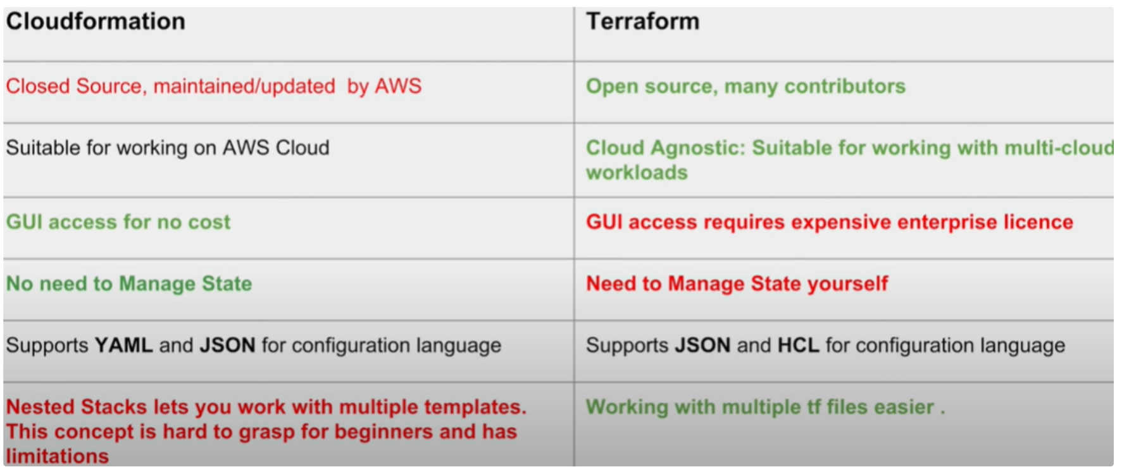
Terraform Vs CloudFormation
What is the main difference between Terraform and CloudForm. Which you choose as a DevOps and why?

Slide 20
AWS CLI INSTALLATION

Slide 21
AWS CLI Installation On Windows and Linux
AWS CLI Installation on Mac OS
https://formulae.brew.sh/formula/awscli#default
brew install awscli
Install Homebrew
https://brew.sh/
/bin/bash -c "$(curl -fsSL https://raw.githubusercontent.com/Homebrew/install/HEAD/install.sh)"
AWS CLI Installation on Linux
https://docs.aws.amazon.com/cli/latest/userguide/getting-started-install.html#cliv2-linux-install
curl "https://awscli.amazonaws.com/awscli-exe-linux-x86_64.zip" -o "awscliv2.zip"
unzip awscliv2.zip
sudo ./aws/install
sudo ./aws/install -i /usr/local/aws-cli -b /usr/local/bin
aws --version

Slide 22
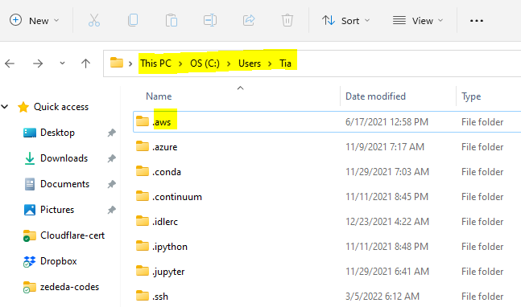
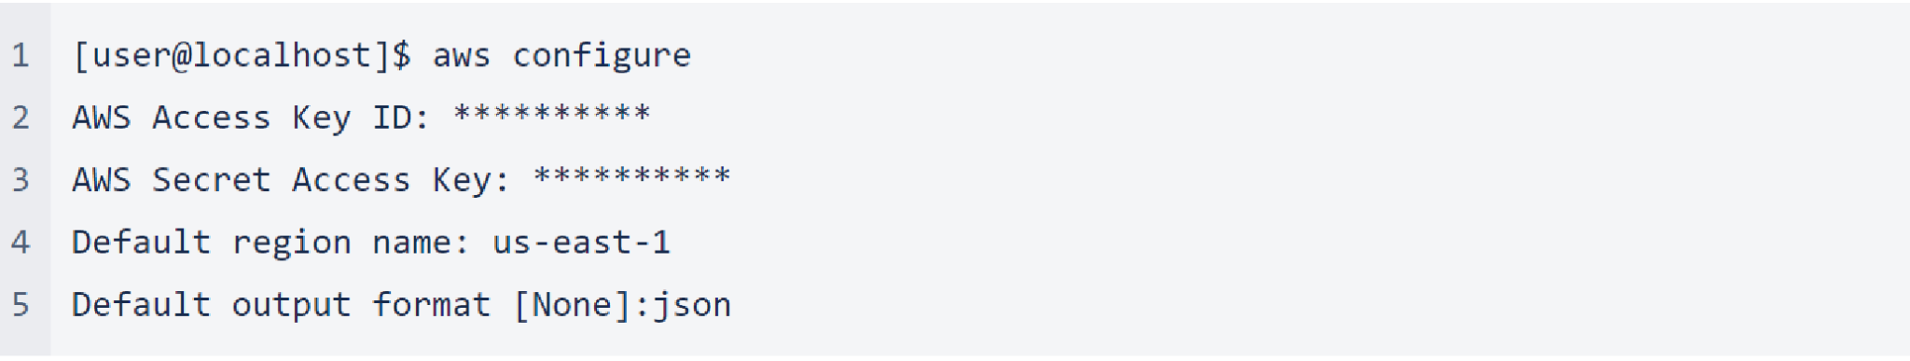
https://levelup.gitconnected.com/install-and-configure-aws-cli-for-deployment-c9148a10902f
AWS CLI Configuration
Steps:
1- Create an IAM user with admin permission
2- Create security credentials and download it
3- Configure AWS Credentials in command line with aws configure
4. Verify if we are able to list S3 buckets
aws s3 ls
PS: On Linux and Mac OS, AWS credentials are stored in ~/.aws
On Windows, AWS credentials are stored in C:\Users\User\user_name\.aws. You must enable hidden files first on Windows

Slide 23
Terraform Installation

Slide 24
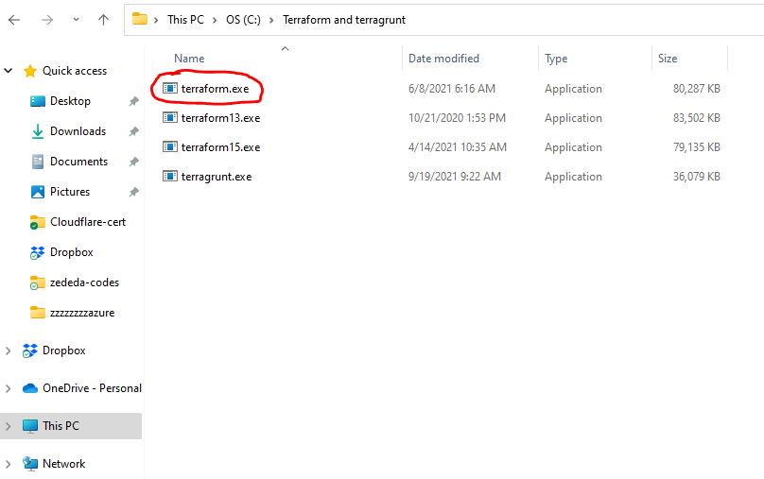
Terraform Installation On Windows
Do not download it straight from the HashiCorp website because it will only download and install the latest version of terraform
Download and install a specific release instead
1. Download the binary
2. Unzip it
3. Create a folder called terraform on the C drive and paste the terraform.exe
4. Type env on the windows search bar and at it to path C:\terraform
We can install multiple versions of Terraform here. The default version that will run if run any terraform command here will be just terraform. If we want to run 13 or 15, we should use terraform13 and terraform15.
PS: Numbers here are just to identify the version. It can be anything
https://releases.hashicorp.com/terraform/
https://developer.hashicorp.com/terraform/downloads

Slide 25
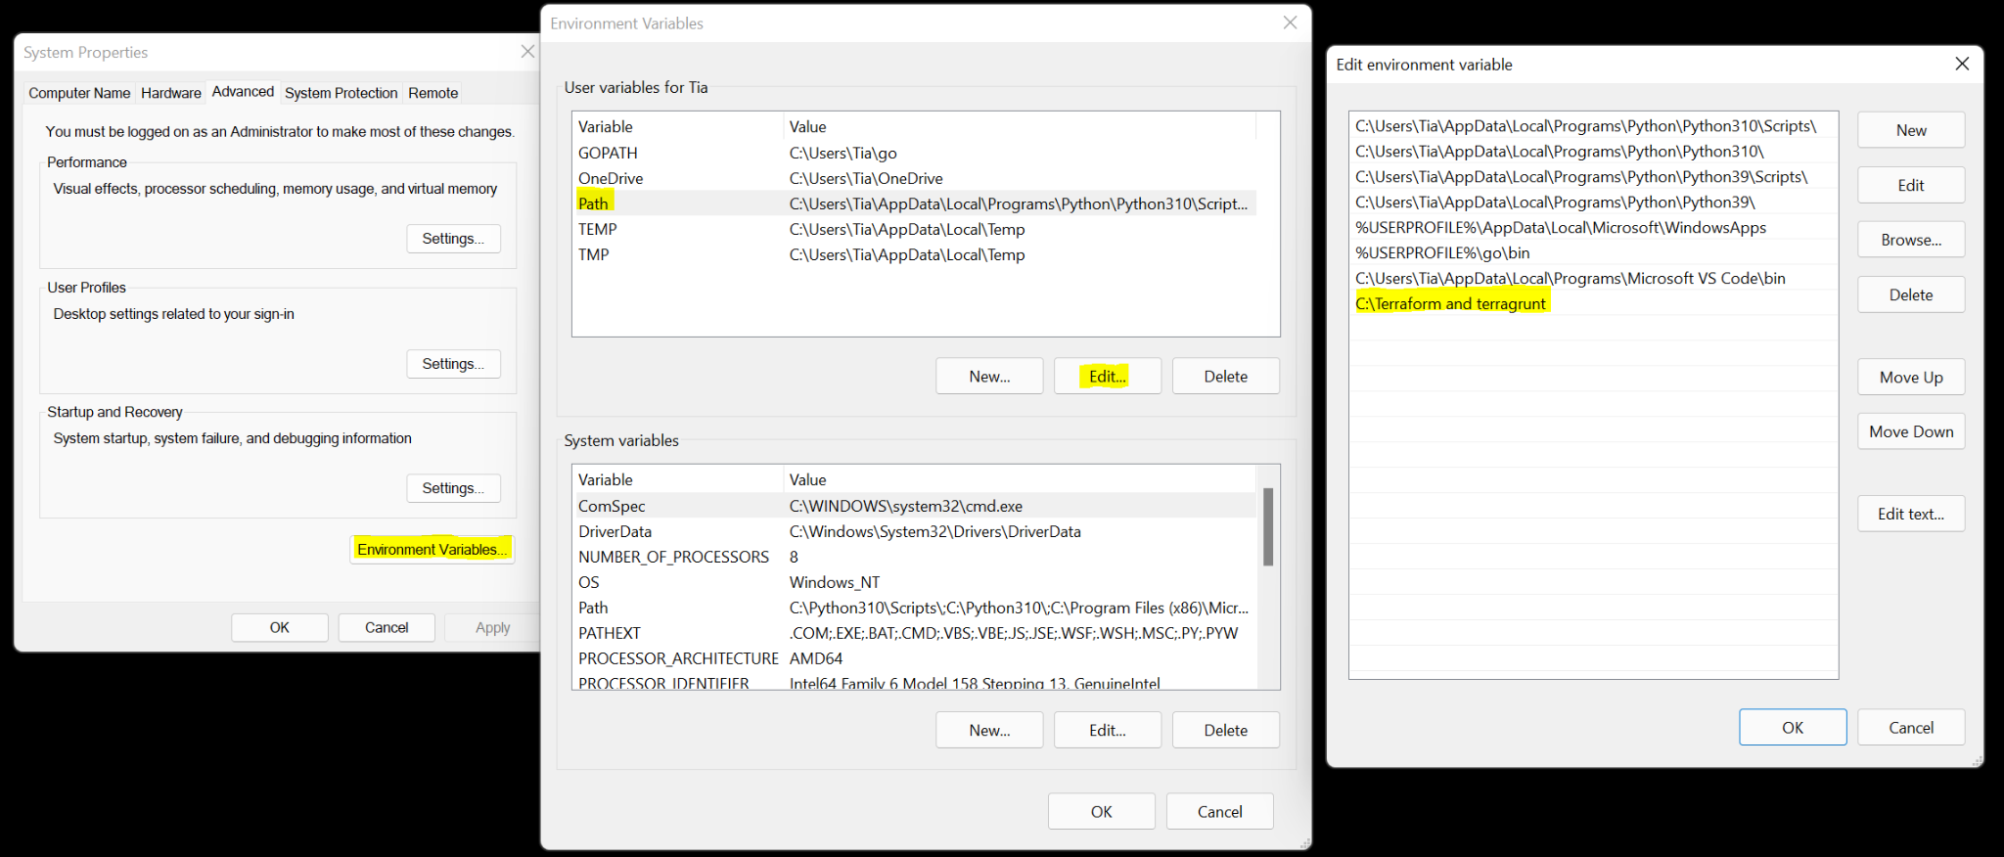
Terraform Installation On Windows
Add Terraform to your path
Type env on your search bar and choose edit environment variable
Select path - edit and add the new path

Slide 26
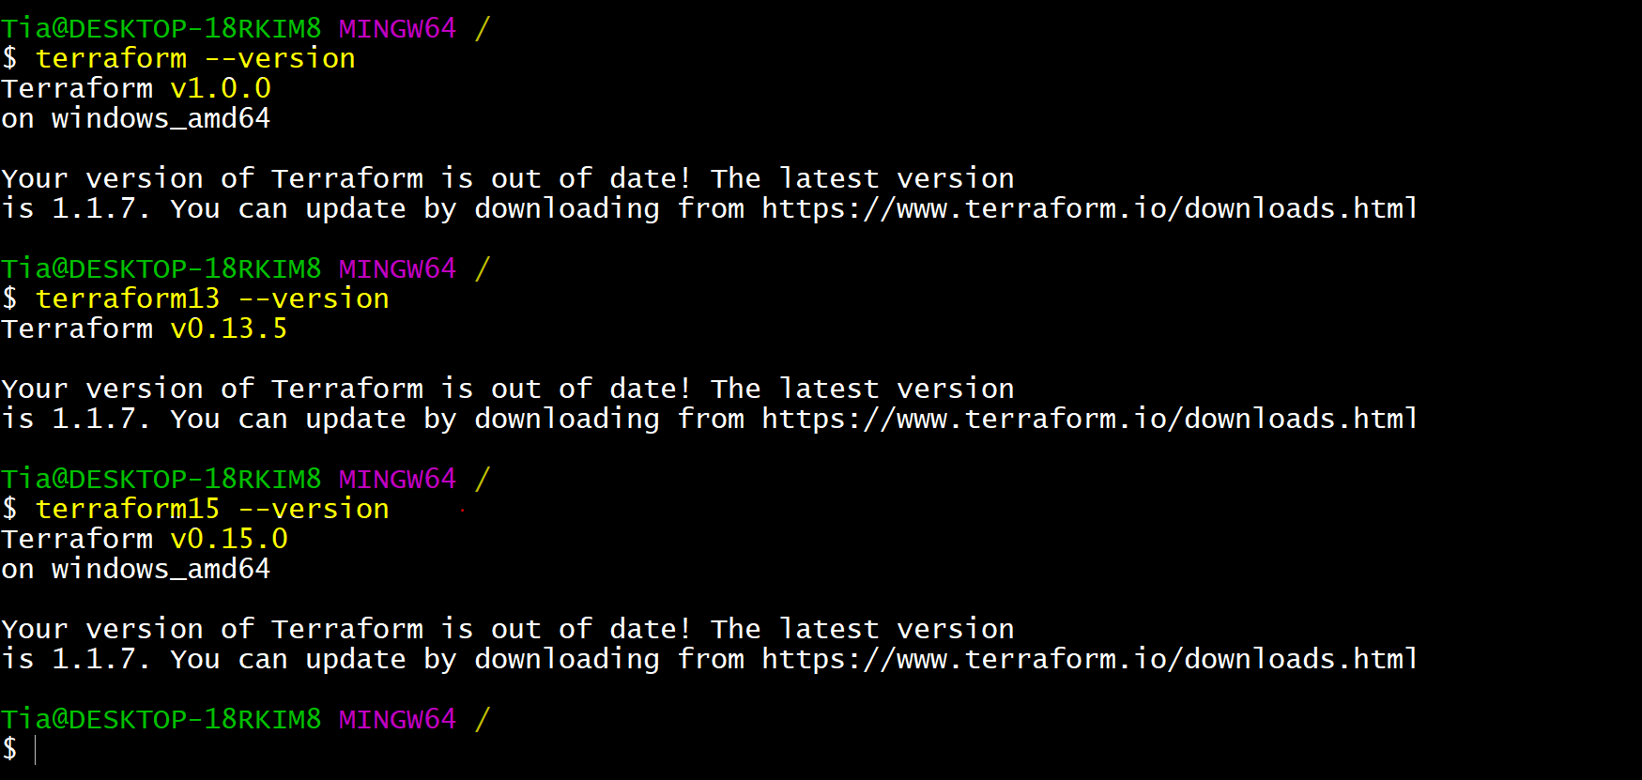
Terraform Installation On Windows
Check the versions

Slide 27
Terragrunt Installation On Linux and Windows
1. Download the binary
2. Unzip it
3. Create a folder called terraform on the C drive and paste the terraform.exe
4. Type env on the windows search bar and at it to path C:\terragrunt
Terragrunt –version
wget https://github.com/gruntwork-io/terragrunt/releases/download/v0.26.7/terragrunt_linux_amd64
mv terragrunt_linux_amd64 terragrunt
chmod u+x terragrunt
mv terragrunt /usr/local/bin/terragrunt
terragrunt --version
https://github.com/gruntwork-io/terragrunt/releases

Slide 28
Terraform Installation on Linux and Mac
### TERRAFORM INSTALLATION
ENV TERRAFORM_VERSION 1.0.0
WORKDIR /tmp
RUN wget -q https://releases.hashicorp.com/terraform/${TERRAFORM_VERSION}/terraform_${TERRAFORM_VERSION}_linux_amd64.zip
unzip terraform_${TERRAFORM_VERSION}_linux_amd64.zip \
mv terraform /usr/local/bin \
rm -f terraform terraform_${TERRAFORM_VERSION}_linux_amd64.zip
### Terraform v1.0.0 installation on Linux
wget https://releases.hashicorp.com/terraform/1.0.0/terraform_1.0.0_linux_amd64.zip
unzip terraform_1.0.0_linux_amd64.zip
./terraform
### Move the binary to the path so that you can run Terraform from any location
mv terraform /usr/local/bin
terraform -version
https://releases.hashicorp.com/terraform/

Slide 29
Terraform Installation on Mac
1. install tfenv and link it
brew install tfenv
brew link tfenv
2. search the remote repo to see all the terraform version
tfenv list-remote
3. Install a particular version
tfenv install 0.13.5
tfenv install 0.13.7
4. Switch to a particular version
tfenv use 0.13.5
tfenv use 0.13.7
5. list all install version
tfenv list
6. Help
tfenv
https://opensource.com/article/20/11/tfenv
https://stackoverflow.com/questions/56283424/upgrade-terraform-to-specific-version
$ tfenv list-remote
0.12.0
0.12.0-rc1
0.12.0-beta2
0.12.0-beta1
0.12.0
0.11.14
...
$ tfenv install 0.11.14
[INFO] Installing Terraform v0.11.14
[INFO] Downloading release tarball from https://releases.hashicorp.com/terraform/0.11.14/terraform_0.11.14_darwin_amd64.zip
...
[INFO] Installation of terraform v0.11.14 successful
[INFO] Switching to v0.11.14
[INFO] Switching completed

Slide 30
Terraform Installation With Docker
FROM ubuntu:latest
RUN apt-get update -y
RUN apt-get install apt-utils -y \
wget \
curl \
vim \
unzip \
git
### AWS CLI INSTALLATIN
RUN curl "https://awscli.amazonaws.com/awscli-exe-linux-x86_64.zip" -o "awscliv2.zip" \
&& unzip awscliv2.zip \
&& aws/install \
&& rm -rf awscliv2.zip \
&& rm -rf aws
### TERRAFORM INSTALLATIN
ENV TERRAFORM_VERSION 1.0.0
WORKDIR /tmp
RUN wget -q https://releases.hashicorp.com/terraform/${TERRAFORM_VERSION}/terraform_${TERRAFORM_VERSION}_linux_amd64.zip \
&& unzip terraform_${TERRAFORM_VERSION}_linux_amd64.zip \
&& mv terraform /usr/local/bin \
&& rm -f terraform terraform_${TERRAFORM_VERSION}_linux_amd64.zip
### TERRAGRUNT INSTALLATIN
ENV TERRAGRUNT_VERSION v0.31.0
RUN wget https://github.com/gruntwork-io/terragrunt/releases/download/${TERRAGRUNT_VERSION}/terragrunt_linux_amd64 \
&& mv terragrunt_linux_amd64 terragrunt \
&& chmod u+x terragrunt \
&& mv terragrunt /usr/local/bin/terragrunt
docker build -t terraform .
docker run --rm -it --workdir "/home/$USER" -v "$PWD":"/home/$USER" terraform bash

Slide 31
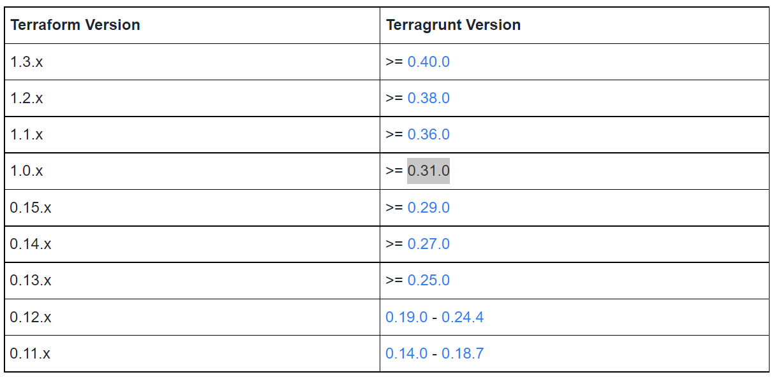
Terraform Compatibility Version with Terragrunt
https://terragrunt.gruntwork.io/docs/getting-started/supported-terraform-versions/

Slide 32
Terraform Basic Commands

Slide 33
Terraform init
terraform init
terraform {
required_version = ">= 1.0.0"
required_providers {
aws = {
source = "hashicorp/aws"
version = "~> 3.0"
}
}
}
provider "aws" {
region = "us-east-1"
}
resource "aws_instance" "app_server" {
ami = "ami-052efd3df9dad4825"
instance_type = "t2.micro"
tags = {
Name = "web01"
}
}
The terraform init command initializes a working directory containing Terraform configuration files. This is the first command that should be run after writing a new Terraform configuration or cloning an existing one from version control. It is safe to run this command multiple times.
This command is similar to git init command in version conversion

Slide 34
Terraform validate
terraform validate
terraform {
required_version = ">= 1.0.0"
required_providers {
aws = {
source = "hashicorp/aws"
version = "~> 3.0"
}
}
}
provider "aws" {
region = "us-east-1"
}
resource "aws_instance" "app_server" {
ami = "ami-052efd3df9dad4825"
instance_type = "t2.micro"
tags = {
Name = "web01"
}
}
The terraform validate command is used to validate the syntax of the terraform files. Terraform performs a syntax check on all the terraform files in the directory, and will display an error if the configuration file is not valid

Slide 35
Terraform fmt
terraform fmt
The terraform fmt command is used to format your configuration files.
As a best practice, terraform fmt should always be run on your configuration files, so formatting standards and language style conventions are applied across your configuration in a uniform manner. This helps code readability and ensures all configuration files are formatted the same, no matter which team member is writing the file. Consistency can help your team understand the code more quickly and easily, making the use of terraform fmt very important.
terraform {
required_version = ">= 1.0.0"
required_providers {
aws = {
source = "hashicorp/aws"
version = "~> 3.0"
}
}
}
provider "aws" {
region = "us-east-1"
}
resource "aws_instance" "app_server" {
ami = "ami-052efd3df9dad4825"
instance_type = "t2.micro"
tags = {
Name = "web01"
}
}

Slide 36
Terraform plan
terraform plan
The terraform plan command creates an execution plan, which lets you preview the changes that Terraform plans to make to your infrastructure.
The plan command reports on changes to infrastructure, but it does not apply any of the proposed changes. Instead, it creates a reviewable execution plan, which you can use to confirm that the proposed changes are expected.
The execution plan can be saved to a file, which can be applied later. The ability to review the proposed changes prior to applying them can save you from making unexpected infrastructure changes. After you have confirmed the changes as expected, use the Terraform apply command to update the remote objects.
terraform {
required_version = ">= 1.0.0"
required_providers {
aws = {
source = "hashicorp/aws"
version = "~> 3.0"
}
}
}
provider "aws" {
region = "us-east-1"
}
resource "aws_instance" "app_server" {
ami = "ami-052efd3df9dad4825"
instance_type = "t2.micro"
tags = {
Name = "web01"
}
}

Slide 37
Terraform apply
terraform apply
The terraform apply command executes the actions proposed in a terraform plan . It is used to deploy your infrastructure. Typically apply should be run after terraform init and terraform plan
If the apply command is run without any options it will run a terraform plan first, ask the user to confirm the planned actions, and then execute those changes once confirmed. By default, a plan will be generated first and will need to be approved before it is applied
terraform {
required_version = ">= 1.0.0"
required_providers {
aws = {
source = "hashicorp/aws"
version = "~> 3.0"
}
}
}
provider "aws" {
region = "us-east-1"
}
resource "aws_instance" "app_server" {
ami = "ami-052efd3df9dad4825"
instance_type = "t2.micro"
tags = {
Name = "web01"
}
}

Slide 38
Terraform apply
terraform apply
terraform apply -auto-approve — Apply changes without having to interactively type ‘yes’ to the plan. Useful in automation CI/CD pipelines.
terraform apply -var="domainpassword=password123" — Pass in a variable value.
terraform apply -var-file="varfile.tfvars" — Pass in variables contained in a file.
terraform apply -lock=false — Do not hold a state lock during the Terraform apply operation. Use with caution if other engineers might run concurrent commands against the same workspace
terraform {
required_version = ">= 1.0.0"
required_providers {
aws = {
source = "hashicorp/aws"
version = "~> 3.0"
}
}
}
provider "aws" {
region = "us-east-1"
}
resource "aws_instance" "app_server" {
ami = "ami-052efd3df9dad4825"
instance_type = "t2.micro"
tags = {
Name = "web01"
}
}

Slide 39
Terraform destroy
terraform destroy
terraform {
required_version = ">= 1.0.0"
required_providers {
aws = {
source = "hashicorp/aws"
version = "~> 3.0"
}
}
}
provider "aws" {
region = "us-east-1"
}
resource "aws_instance" "app_server" {
ami = "ami-052efd3df9dad4825"
instance_type = "t2.micro"
tags = {
Name = "web01"
}
}
The Terraform destroy command is a command that terminates resources managed by your current Terraform project by deleting infrastructure resources present in the state file. When the destroy command is executed, Terraform first validates the information contained in the state file by cross-checking with cloud provider APIs

Slide 40
Terraform Provide

Slide 41
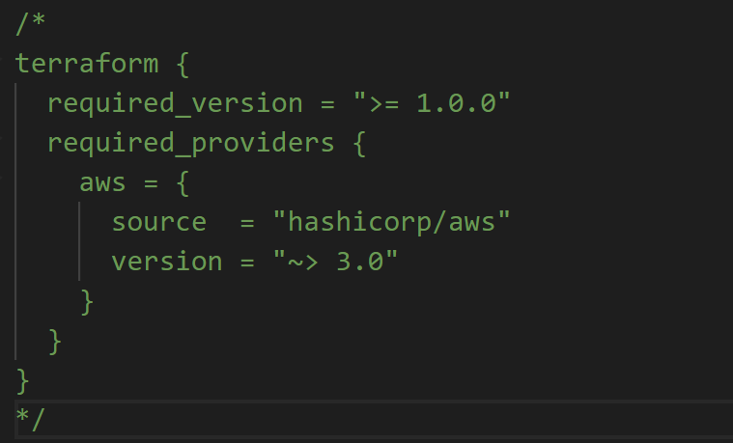
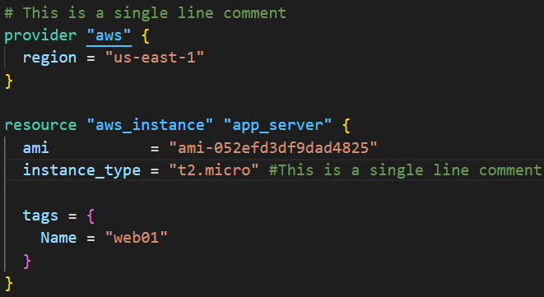
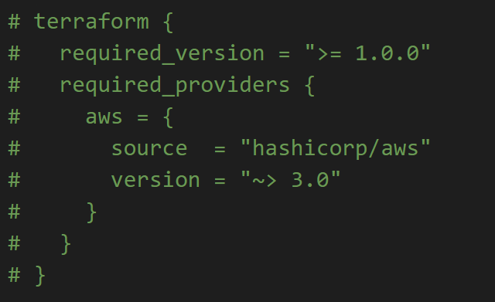
Terraform comments
The Terraform language supports 2 different syntaxes for comments:
# begins a single-line comment (this is a single line comment)
/* and */ are start and end delimiters for a comment that might span over multiple lines (this is a multiple line comment)

Slide 42
Terraform Variables
Terraform input variables provides an easy and more flexible way to define values so that we can change the configuration of the terraform as per our need.
The Terraform language uses the following types of variables:
string: a sequence of Unicode characters representing some text, like "hello".
number: a numeric value. The number type can represent both whole numbers like 15 and fractional values like 6.283185. In the real world, we use a string or a list of string instead of number
bool: a boolean value, either true or false. bool values can be used in conditional logic.
list (or tuple): a sequence of values, like ["us-west-1a", "us-west-1c"]. Elements in a list or tuple are identified by consecutive whole numbers, starting with zero.
map (or object)
Local variables
Input variables

Slide 43
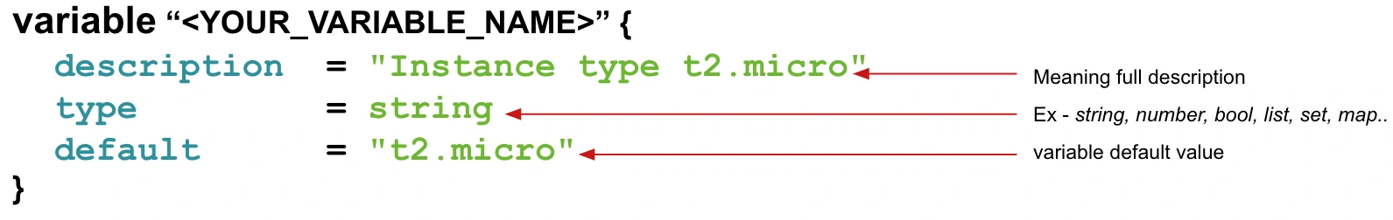
Terraform Variable Definition
This name can be anything. It is just the name that terraform uses in the state file and it is also use to refer the variable

Slide 44
Terraform Local Variable
Local variables are blocks of code within Terraform that allow us to store data that might change overtime. Local values can be helpful to avoid repeating the same values or expressions multiple times in a configuration and also avoid hardcoded in the code. Local variables can be defined in one configuration file and used in others configuration files
provider "aws" {
region = "us-east-1"
}
locals {
instance_name = "dev-instance"
instance_type = "t2.micro"
instance_key = "jenkins-key"
instance_ami = "ami-04d29b6f966df1537"
}
resource "aws_instance" "myec3" {
ami = local.instance_ami
instance_type = local.instance_type
key_name = local.instance_key
tags = {
"Name" = "${local.instance_name}-tia"
"Env" = "Dev"
}
}
Local variables definition
Local variables substitution with the variable value

Slide 45
Terraform String Variable
String variable type - We are going parameterized instance_type = “t2.micro”
The first rule to create a parameter in terraform file is by defining a variable block
provider "aws" {
region = "us-east-1"
}
resource "aws_instance" "ec2_example" {
ami = "ami-0767046d1677be5a0"
instance_type = var.instance_type
tags = {
Name = "Terraform EC2"
}
}
variable "instance_type" {
description = "Instance type t2.micro"
type = string
default = "t2.micro"
}
variable "instance_type" {
description = "Instance type t2.micro"
type = string
default = "t2.micro"
}
description: Small or short description about the purpose of the variable
type: What type of variable it is going to be ex - string, bool, number …
default: What would be the default value of the variable

Slide 46
Terraform Boolean Variable
boolean variable type - We are going parameterized enable_public_ip = true
The bool variable can be used to set true or false values inside your terraform file.
Here is an example to create your bool variable
provider "aws" {
region = "us-east-1"
}
resource "aws_instance" "ec2_example" {
ami = "ami-0767046d1677be5a0"
instance_type = var.instance_type
associate_public_ip_address = var.enable_public_ip
tags = {
Name = "Terraform EC2"
}
}
variable "instance_type" {
description = "Instance type t2.micro"
type = string
default = "t2.micro"
}
variable "enable_public_ip" {
description = "Enable public IP address"
type = bool
default = true
}
variable "enable_public_ip" {
description = "Enable public IP address"
type = bool
default = true
}
description: Small or short description about the purpose of the variable
type: What type of variable it is going to be ex - string, bool, number, map, list etc.
default: What would be the default value of the variable

Slide 47
Terraform map Variable
Terraform also supports the map variable type where you can define the key-value pair.
Let’s take an example where we need to define project and environment, so we can use the map variable to achieve that.
Here is an example of map variable
provider "aws" {
region = "us-east-1"
}
resource "aws_instance" "ec2_example" {
ami = "ami-0767046d1677be5a0"
instance_type = "t2.micro"
Associate_public_ip_address = true
tags = var.project_environment
}
variable "project_environment" {
description = "project name and environment"
type = map(string)
default = {
project = "project-alpha",
environment = "dev"
Create_by = "Terraform"
}
}
variable "project_environment" {
description = "project name and environment"
type = map(string)
default = {
project = "project-alpha",
environment = "dev"
}
}
description: Small or short description about the purpose of the variable
type: What type of variable it is going to be ex - string, bool, number, map, list etc.
default: What would be the default value of the variable

Slide 48
Terraform list Variable
Let’s define our first List variable -
Here is the list of IAM users
provider "aws" {
region = "us-east-1"
}
variable "user_names" {
description = "IAM usernames"
type = list(string)
default = ["user1", "user2", "user3"]
}
resource "aws_iam_user" "user1" {
name = "user1"
}
resource "aws_iam_user" "user2" {
name = "user2"
}
resource "aws_iam_user" "user3" {
name = "user3"
}
variable "user_names" {
description = "IAM usernames"
type = list(string)
default = ["user1", "user2", "user3"]
}
description: Small or short description about the purpose of the variable
type: What type of variable it is going to be ex - string, bool, number, map, list etc.
default: What would be the default value of the variable

Slide 49
Terraform Loops

Slide 50
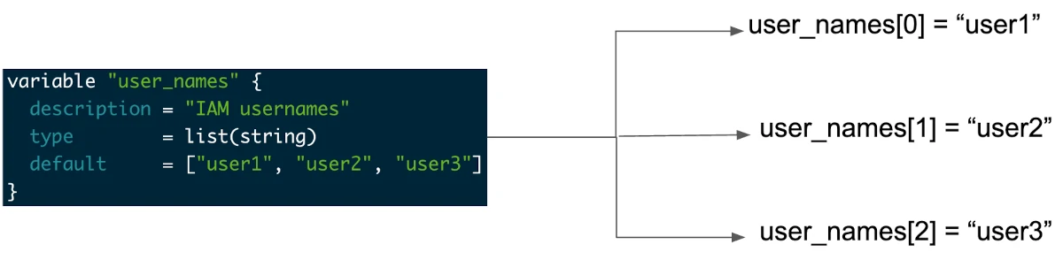
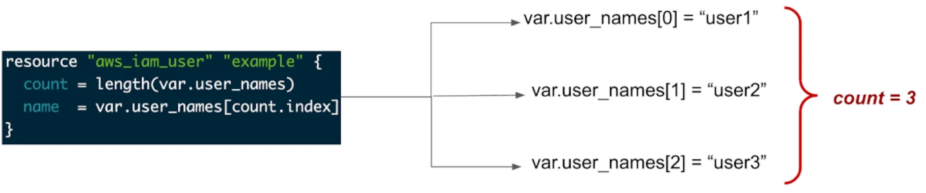
Terraform Loops With Count

Slide 51
Terraform Loops With Count
provider "aws" {
region = "us-east-1"
}
variable "user_names" {
description = "IAM usernames"
type = list(string)
default = ["user1", "user2", "user3"]
}
resource "aws_iam_user" "user1" {
name = "user1"
}
resource "aws_iam_user" "user2" {
name = "user2"
}
resource "aws_iam_user" "user3" {
name = "user3"
}
provider "aws" {
region = "us-east-1"
}
variable "user_names" {
description = "IAM usernames"
type = list(string)
default = ["user1", "user2", "user3"]
}
resource "aws_iam_user" "example" {
count = length(var.user_names)
name = var.user_names[count.index]
}

Slide 52
Terraform Loops With Count
provider "aws" {
region = "us-east-1"
}
resource "aws_instance" "app_server1" {
ami = "ami-052efd3df9dad4825"
instance_type = "t2.micro"
tags = {
Name = "web-server-0"
}
}
resource "aws_instance" "app_server2" {
ami = "ami-052efd3df9dad4825"
instance_type = "t2.micro"
tags = {
Name = "web-server-1"
}
}
resource "aws_instance" "app_server3" {
ami = "ami-052efd3df9dad4825"
instance_type = "t2.micro"
tags = {
Name = "web-server-2"
}
}
provider "aws" {
region = "us-east-1"
}
resource "aws_instance" "app_server" {
ami = "ami-052efd3df9dad4825"
instance_type = "t2.micro"
count = 3
tags = {
Name = "web-server-${count.index}"
}
}

Slide 53
Terraform Loops With Count and for each
provider "aws" {
region = "us-east-1"
}
variable "user_names" {
description = "IAM usernames"
type = list(string)
default = ["user1", "user2", "user3"]
}
resource "aws_iam_user" "example1" {
count = length(var.user_names)
name = var.user_names[count.index]
}
resource "aws_iam_user" "example2" {
for_each = var.user_names
name = each.value
}
provider "aws" {
region = "us-east-1"
}
variable "user_names" {
description = "IAM usernames"
type = list(string)
default = ["user1", "user2", "user3"]
}
resource "aws_iam_user" "user1" {
name = "user1"
}
resource "aws_iam_user" "user2" {
name = "user2"
}
resource "aws_iam_user" "user3" {
name = "user3"
}

Slide 54



Loops with count Vs Loops with for_each

Slide 55
Terraform Loops With Count and for each
provider "aws" {
region = "us-east-1"
}
variable "aws-secret-string" {
type = list(string)
default = [
"jenkins",
"splunk_key",
"argocd",
"aws-key",
"elk-key"
]
}
resource "aws_secretsmanager_secret" "example" {
count = length(var.aws-secret-string)
name = var.aws-secret-string[count.index]
tags = {
"Terraform" = "true"
"Project" = "MAM"
}
}
variable "aws-secret-string" {
type = set(string)
default = [
"jenkins",
"splunk_key",
"aws-key",
"elk-key"
]
}
resource "aws_secretsmanager_secret" "example" {
for_each = var.aws-secret-string
name = each.value
tags = {
"Terraform" = "true"
"Project" = "MAM"
}
}

Slide 56
Terraform Providers

Slide 57
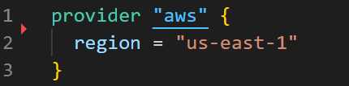
Terraform Providers
Terraform relies on plugins called "providers" to interact with cloud providers, SaaS providers, and other APIs. Terraform configurations must declare which providers they require so that Terraform can install and use them.
Providers are HEART of Terraform
Without Providers, Terraform cannot manage any infrastructure.
Providers are distributed separately from Terraform and each provider has its own release cycles and Version Numbers
Terraform Registry is publicly available which contains many Terraform Providers for most major Infra Platforms
https://registry.terraform.io/browse/providers

Slide 58
Terraform Providers
Terraform Registry: It is a repository where we can find all Terraform providers
https://registry.terraform.io/
https://registry.terraform.io/providers/hashicorp/aws/latest
Official providers are owned and maintained by HashiCorp
https://registry.terraform.io/browse/providers?tier=official
Official providers are owned and maintained by HashiCorp
https://registry.terraform.io/browse/providers?tier=official
Verified providers are owned and maintained by third-party technology partners (Third-party organizations)
https://registry.terraform.io/providers/zededa/zedcloud/1.0.1
Community providers are published to the Terraform Registry by individual maintainers, groups of maintainers, or other members of the Terraform community.
https://registry.terraform.io/browse/providers?tier=community

Slide 59
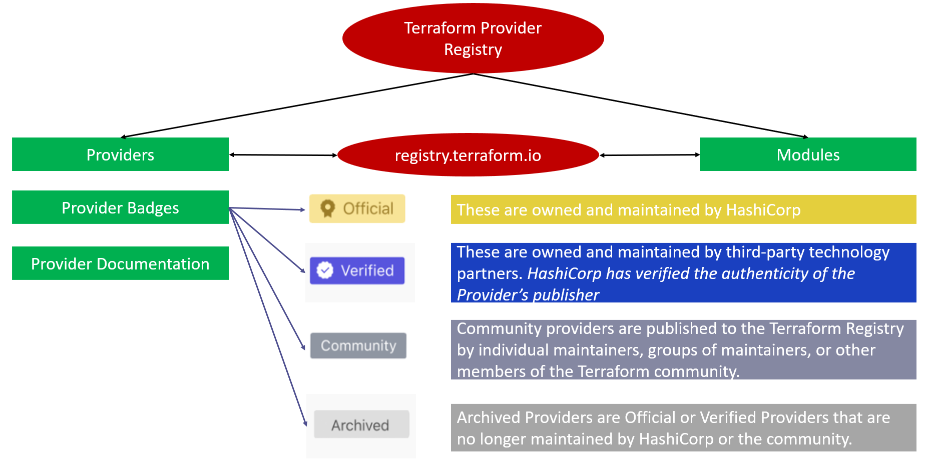
Terraform Providers

Slide 60
terraform {
required_version = ">= 1.0.0"
required_providers {
aws = {
source = "hashicorp/aws"
version = "~> 3.0"
}
google = {
source = "hashicorp/google"
version = "~> 3.76.0"
}
null = {
source = "hashicorp/null"
version = "~> 3.1.0"
}
azurerm = {
source = "hashicorp/azurerm"
version = "~> 2.69.0"
}
helm = {
source = "hashicorp/helm"
version = "~> 2.5"
}
kubernetes = {
source = "hashicorp/kubernetes"
version = "~> 2.11"
}
http = {
source = "hashicorp/http"
#version = "2.1.0"
version = "~> 2.1"
}
}
}
Terraform Providers Version
Terraform Provider Versioning
Terraform Provider Versioning
The provide add as a middle or interface between terraform and the service provider
The provider has multiple versioning. For instance, Windows have a lot of versions such as Windows 10, 7, XP, server, and so on.
Provider plugins are released separately from Terraform itself.
They have a different set of version numbers.
Official providers are owned and maintained by HashiCorp
https://registry.terraform.io/browse/providers?tier=official

Slide 61
terraform {
required_version = ">= 1.0.0"
required_providers {
aws = {
source = "hashicorp/aws"
version = "~> 3.0"
}
google = {
source = "hashicorp/google"
version = "~> 3.76.0"
}
null = {
source = "hashicorp/null"
version = "~> 3.1.0"
}
azurerm = {
source = "hashicorp/azurerm"
version = "~> 2.69.0"
}
helm = {
source = "hashicorp/helm"
version = "~> 2.5"
}
kubernetes = {
source = "hashicorp/kubernetes"
version = "~> 2.11"
}
http = {
source = "hashicorp/http"
#version = "2.1.0"
version = "~> 2.1"
}
}
}
Terraform Providers Version
Explicitly Setting Provider Version
During terraform init, if the version argument is not specified, the most recent provider will be downloaded during initialization.
For production use, you should constrain the acceptable provider versions via configuration, to ensure that new versions with breaking changes will not be automatically installed.
We ne to set the provider version because the new version must be tested in the test environment before deploying to production.
Setting the provider version will for terraform to use a specify provider is of latest provider
Official providers are owned and maintained by HashiCorp
https://registry.terraform.io/browse/providers?tier=official

Slide 62
terraform {
required_version = ">= 1.0.0"
required_providers {
aws = {
source = "hashicorp/aws"
version = "~> 3.0"
}
google = {
source = "hashicorp/google"
version = "~> 3.76.0"
}
null = {
source = "hashicorp/null"
version = "~> 3.1.0"
}
azurerm = {
source = "hashicorp/azurerm"
version = "~> 2.69.0"
}
helm = {
source = "hashicorp/helm"
version = "~> 2.5"
}
kubernetes = {
source = "hashicorp/kubernetes"
version = "~> 2.11"
}
http = {
source = "hashicorp/http"
#version = "2.1.0"
version = "~> 2.1"
}
}
}
Terraform Providers Version
Arguments for Specifying the provider
There are multiple ways of specifying the version of a provider.
>=1.0: Download plugins that are greater than or equal to one
<=1.0: Download plugins that are less than or equal to one
~>2.0: Download plugins in the 2.X range. ~> Allows only the rightmost version component to increment. For example, to allow new patch releases within a specific minor release, use the full version number: ~> 1.0.4 will allow installation of 1.0.5 and 1.0.10 but not 1.1.0. This is usually called the pessimistic constraint operator.
>=2.10,<=2.30: Download any plugins version between 2.10 and 2.30
Official providers are owned and maintained by HashiCorp
https://registry.terraform.io/browse/providers?tier=official

Slide 63
Terraform Required Version
# Play with Terraform CLI Version (We installed 1.0.0 version)
required_version = "~> 0.14.3" - Will fail (we can only have [0.14.0-0.14.9])
required_version = "~> 0.14" - Will fail
required_version = "= 0.14.4" - Will fail
required_version = ">= 0.13" - will pass
required_version = "= 1.0.0" - will pass
required_version = "1.0.0" - will pass
required_version = ">= 1.0.0" - will pass
required_version = "> 1.0.0" - will fail
Create a simple terraform block and play with required_version
required_version focuses on underlying Terraform CLI installed on your desktop
If the running version of Terraform on your local desktop doesn't match the constraints specified in your terraform block, Terraform will produce an error and exit without taking any further actions.
By changing the versions try to terraform init and observe whats happening
# Terraform Block
terraform {
required_version = ">= 1.0.0"
}
Official providers are owned and maintained by HashiCorp
https://registry.terraform.io/browse/providers?tier=official

Slide 64
terraform {
required_version = ">= 1.0.0"
required_providers {
aws = {
source = "hashicorp/aws"
version = "~> 3.0"
}
google = {
source = "hashicorp/google"
version = "~> 3.76.0"
}
null = {
source = "hashicorp/null"
version = "~> 3.1.0"
}
azurerm = {
source = "hashicorp/azurerm"
version = "~> 2.69.0"
}
helm = {
source = "hashicorp/helm"
version = "~> 2.5"
}
kubernetes = {
source = "hashicorp/kubernetes"
version = "~> 2.11"
}
http = {
source = "hashicorp/http"
#version = "2.1.0"
version = "~> 2.1"
}
}
}
Terraform Required Version
If we do not provide the to provider version, terraform will download the latest provider version and use it
If we do not specify the version constraint, terraform will use the version install by default to create the resources
terraform {
required_version = ">= 1.0.0"
required_providers {
aws = {
source = "hashicorp/aws"
version = "~> 3.0"
}
}
}
resource "aws_s3_bucket" "terraform_s3" {
bucket = "terraform-bucket-232"
acl = "private"
}
provider "aws" {
region = "us-east-1"
}
resource "aws_s3_bucket" "terraform_s3" {
bucket = "terraform-bucket-232"
acl = "private"
}
Official providers are owned and maintained by HashiCorp
https://registry.terraform.io/browse/providers?tier=official

Slide 65
Terraform Workflow

Slide 66
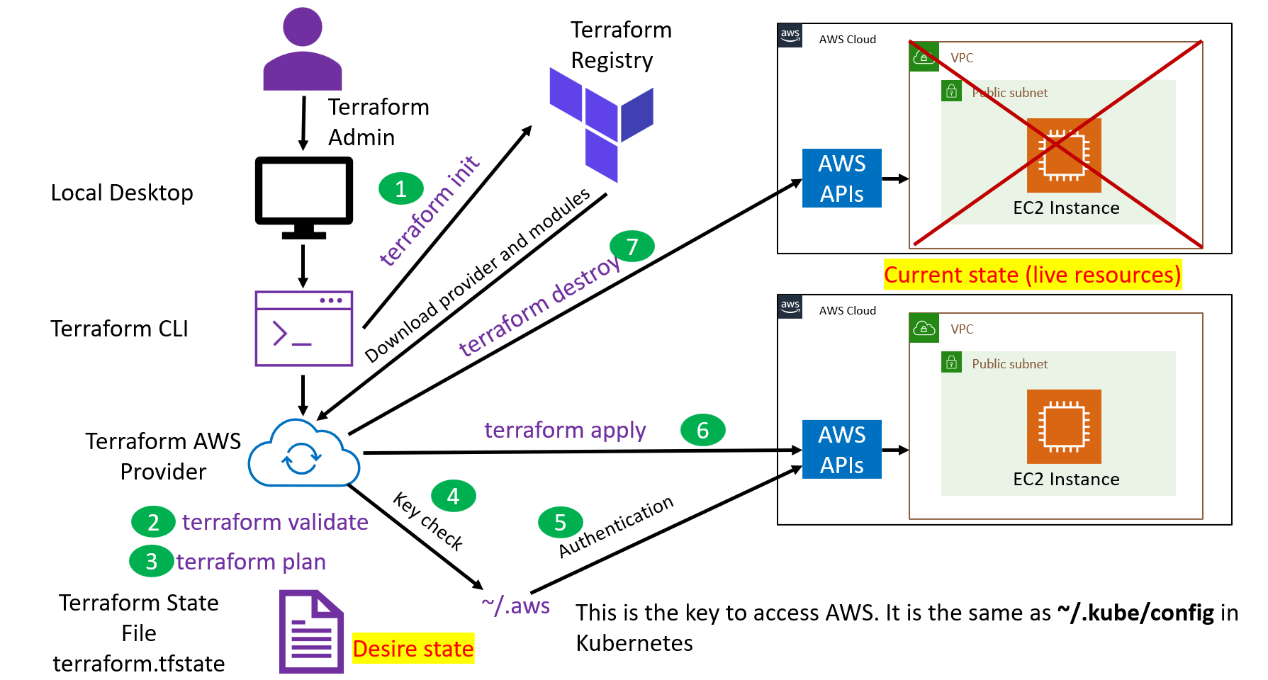
Terraform Workflow
What happened behind the scene when we type the terraform commands below? This similar to what happened the scene when you type kubectl apply?
terraform init
terraform validate
terraform fmt
terraform plan
terraform apply
terraform destroy

Slide 67
Terraform Workflow

Slide 68
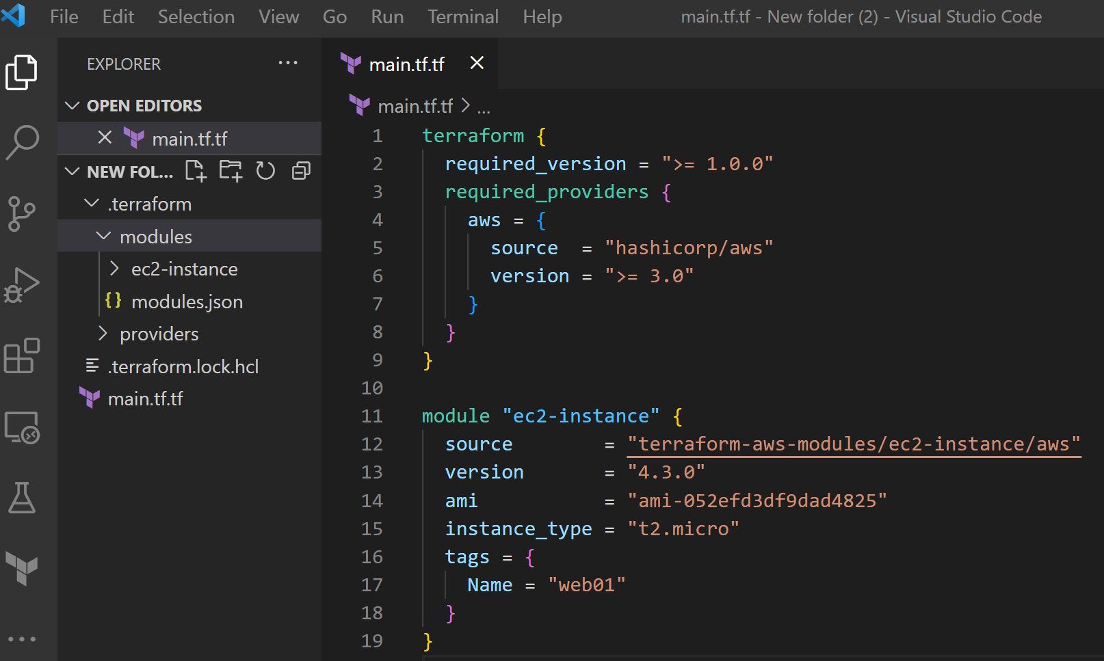
Terraform init
Terraform init will download the provider, all the modules and store it local and it will no do anything
It will also create .terraform.lock.hcl to lock the provider constraint
terraform {
required_version = ">= 1.0.0"
required_providers {
aws = {
source = "hashicorp/aws"
version = ">= 3.0"
}
}
}
module "ec2-instance" {
source = "terraform-aws-modules/ec2-instance/aws"
version = "4.3.0"
ami = "ami-052efd3df9dad4825"
instance_type = "t2.micro"
tags = {
Name = "web01"
}
}

Slide 69
https://build5nines.com/terraform-dependency-lock-file-terraform-lock-hcl/
Terraform Dependency Lock File (.terraform.lock.hcl)
Note: The dependency lock file (.terraform.lock.hcl) is a feature that relates to the use of Terraform 0.14 and later, as tracking dependency selections was added in version 0.14. Older versions did not track the dependency selections.
terraform {
required_version = ">= 1.0.0"
required_providers {
aws = {
source = "hashicorp/aws"
version = ">= 3.0"
}
}
}
module "ec2-instance" {
source = "terraform-aws-modules/ec2-instance/aws"
version = "4.3.0"
ami = "ami-052efd3df9dad4825"
instance_type = "t2.micro"
tags = {
Name = "web01"
}
}
Every Terraform project has external dependencies on code that does not exist within the project itself. These external dependencies rely on Terraform Providers and Modules that may exist outside the code base of the Terraform project. Terraform 0.14 and later uses the Dependency Lock File track its decision from one run to another on determining which dependencies are potentially compatible with the current configuration to select the appropriate dependency versions for use.
why
PS:
The dependency lock file (.terraform.lock.hcl) should be checkout in the version control system
In the real, if you are have an issue with terraform init, please delete the The dependency lock file (.terraform.lock.hcl) and try it again
https://build5nines.com/terraform-dependency-lock-file-terraform-lock-hcl/

Slide 70
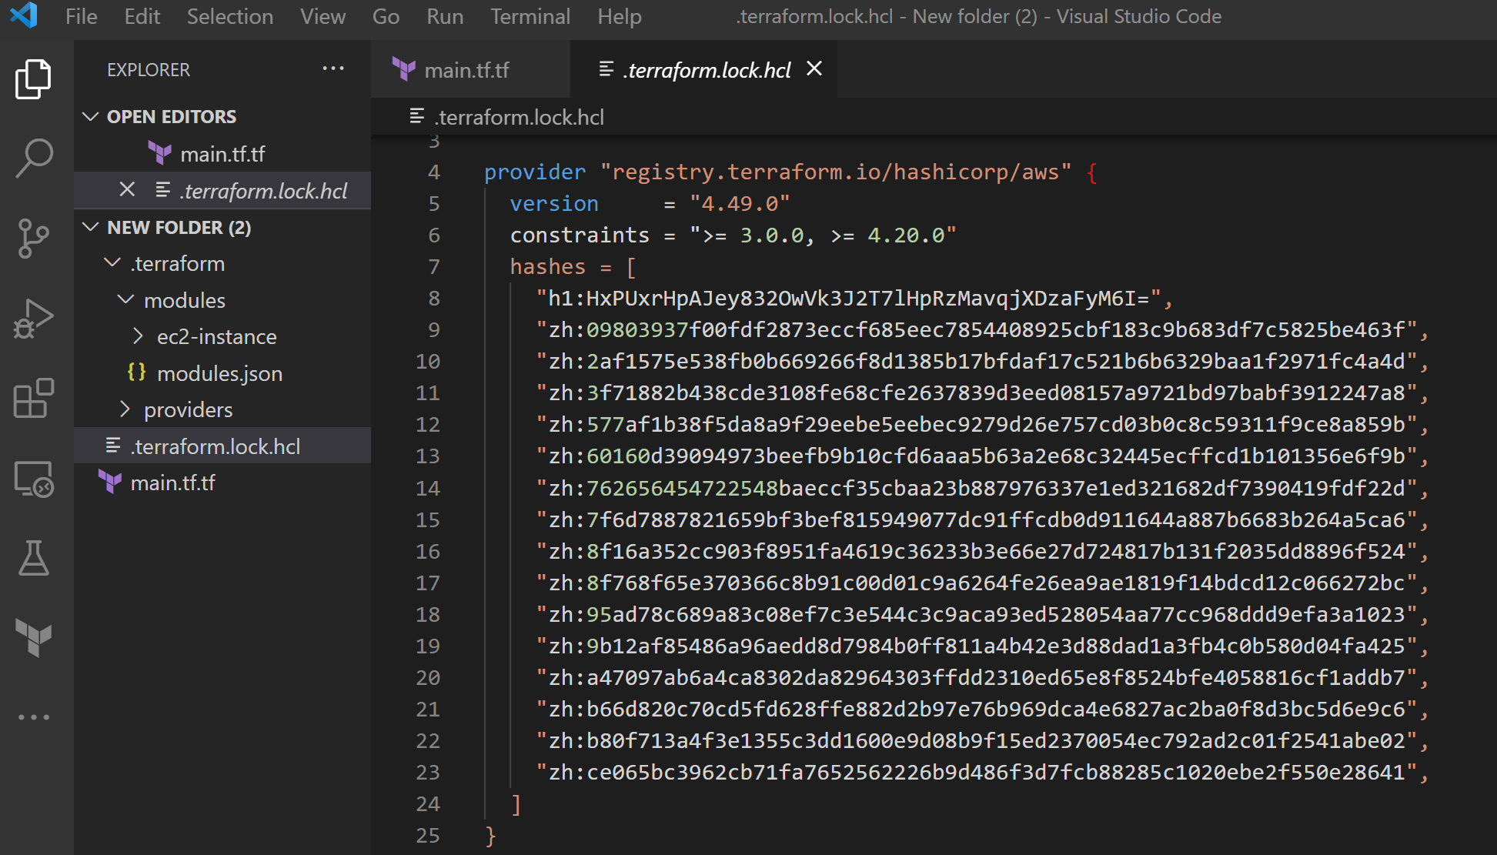
Terraform Dependency Lock File (.terraform.lock.hcl)
dependency lock file (.terraform.lock.hcl)
terraform {
required_version = ">= 1.0.0"
required_providers {
aws = {
source = "hashicorp/aws"
version = ">= 3.0"
}
}
}
module "ec2-instance" {
source = "terraform-aws-modules/ec2-instance/aws"
version = "4.3.0"
ami = "ami-052efd3df9dad4825"
instance_type = "t2.micro"
tags = {
Name = "web01"
}
}
https://build5nines.com/terraform-dependency-lock-file-terraform-lock-hcl/

Slide 71
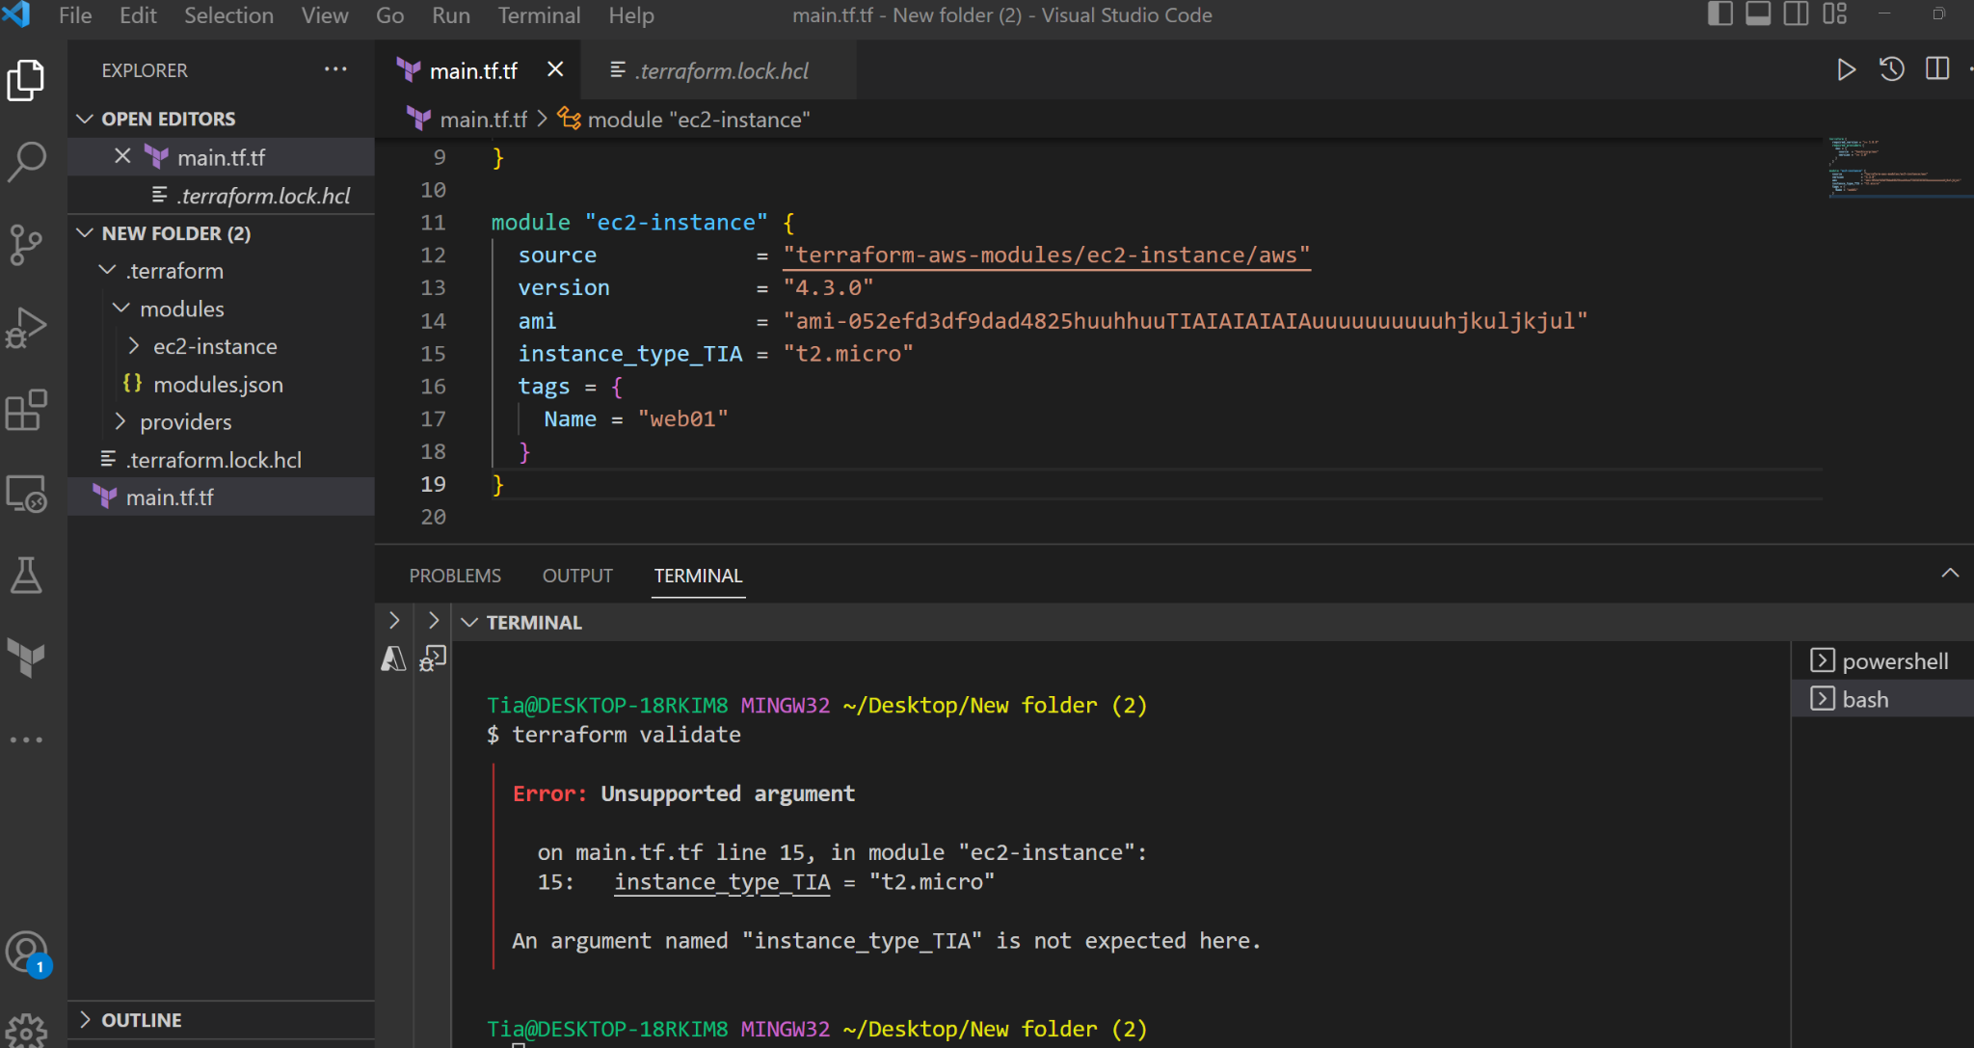
Terraform valide
This will validate all the configuration syntax and make sure all syntax are correct
This is the issue
Line number

Slide 72
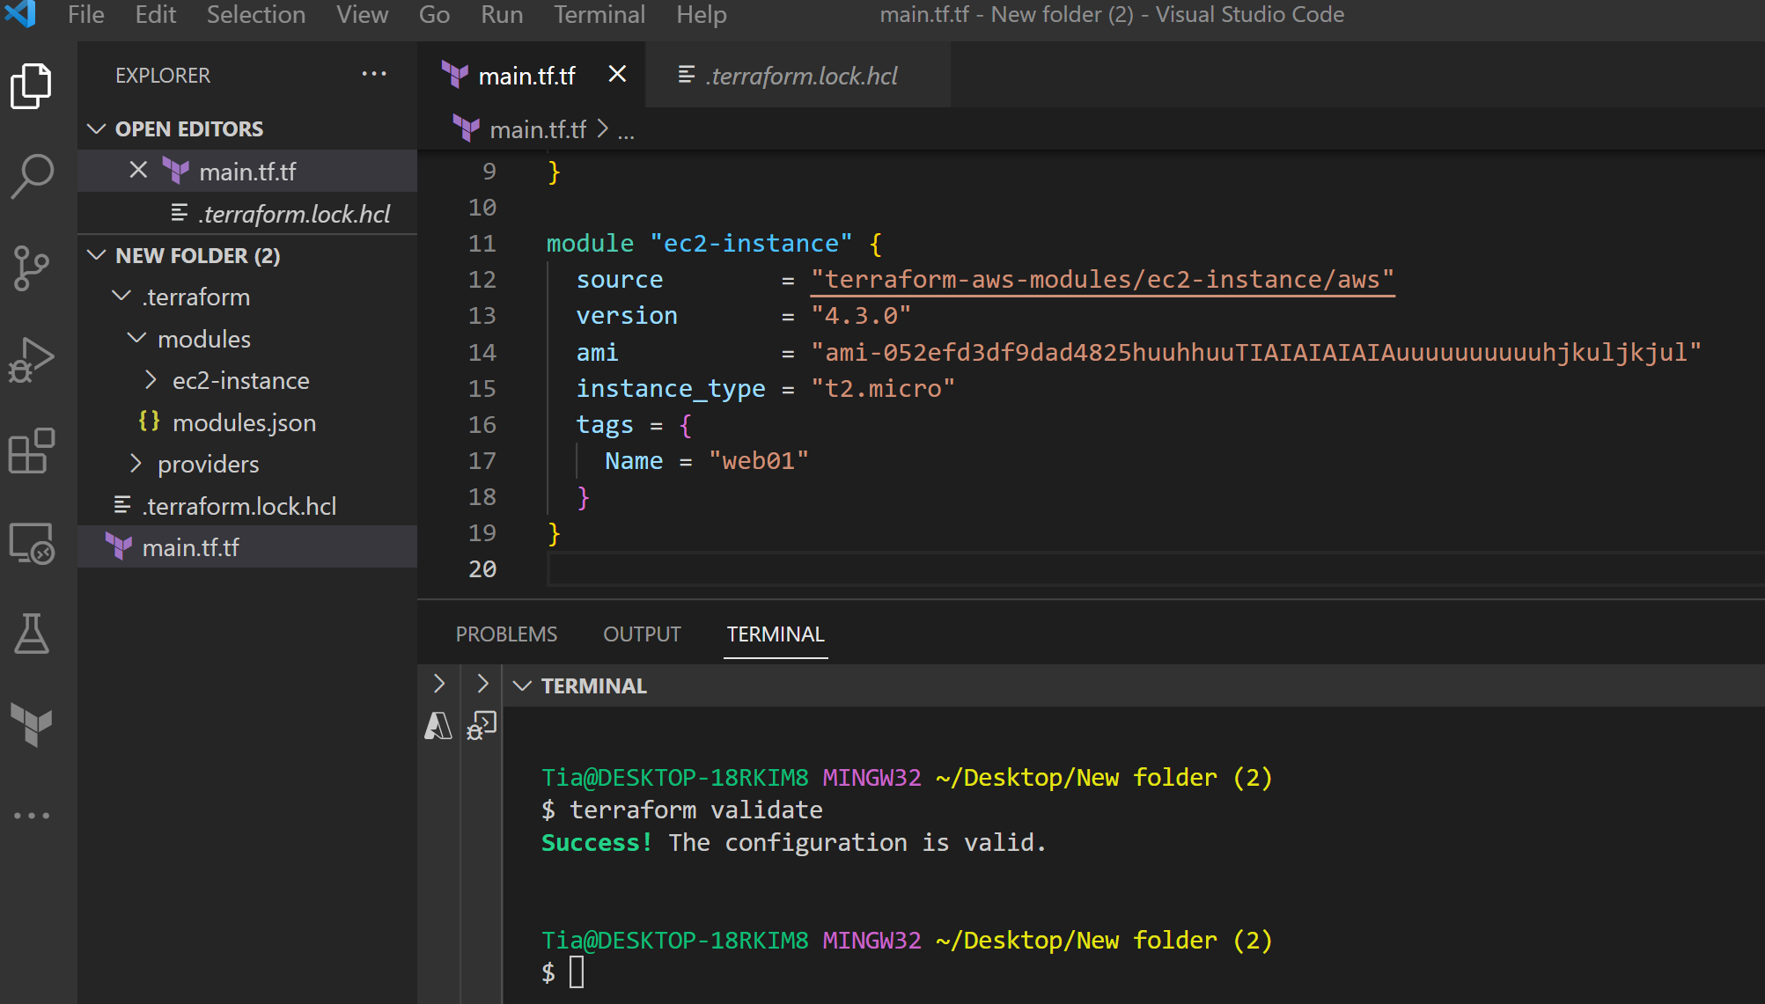
Terraform validate
Terraform validate will not be able to catch this typos. This will failed during terraform apply because the AMI is wrong

Slide 73
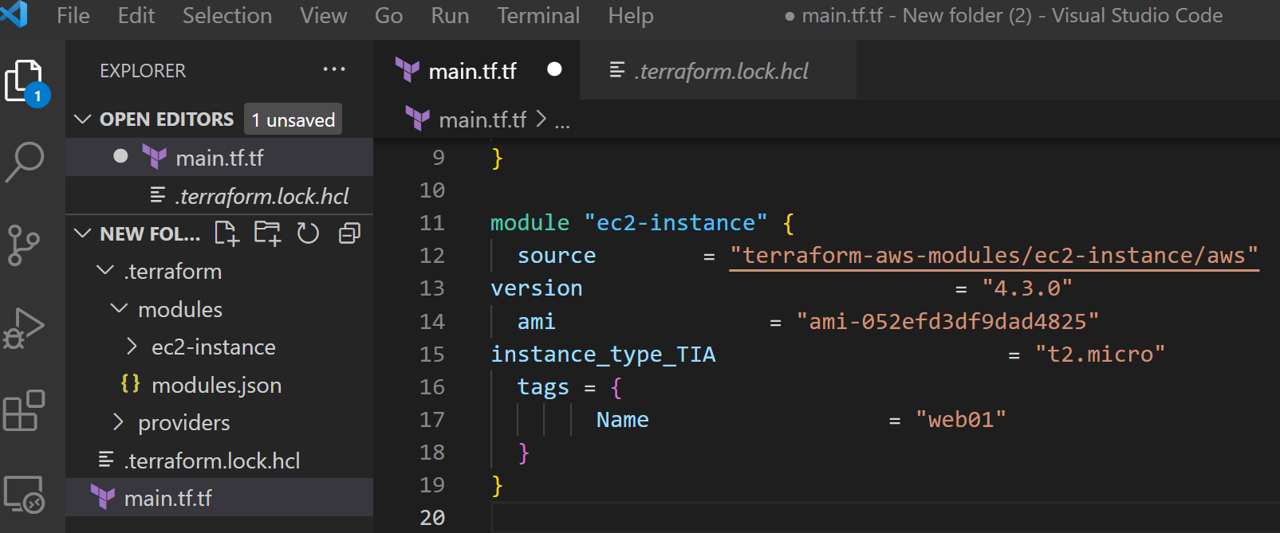
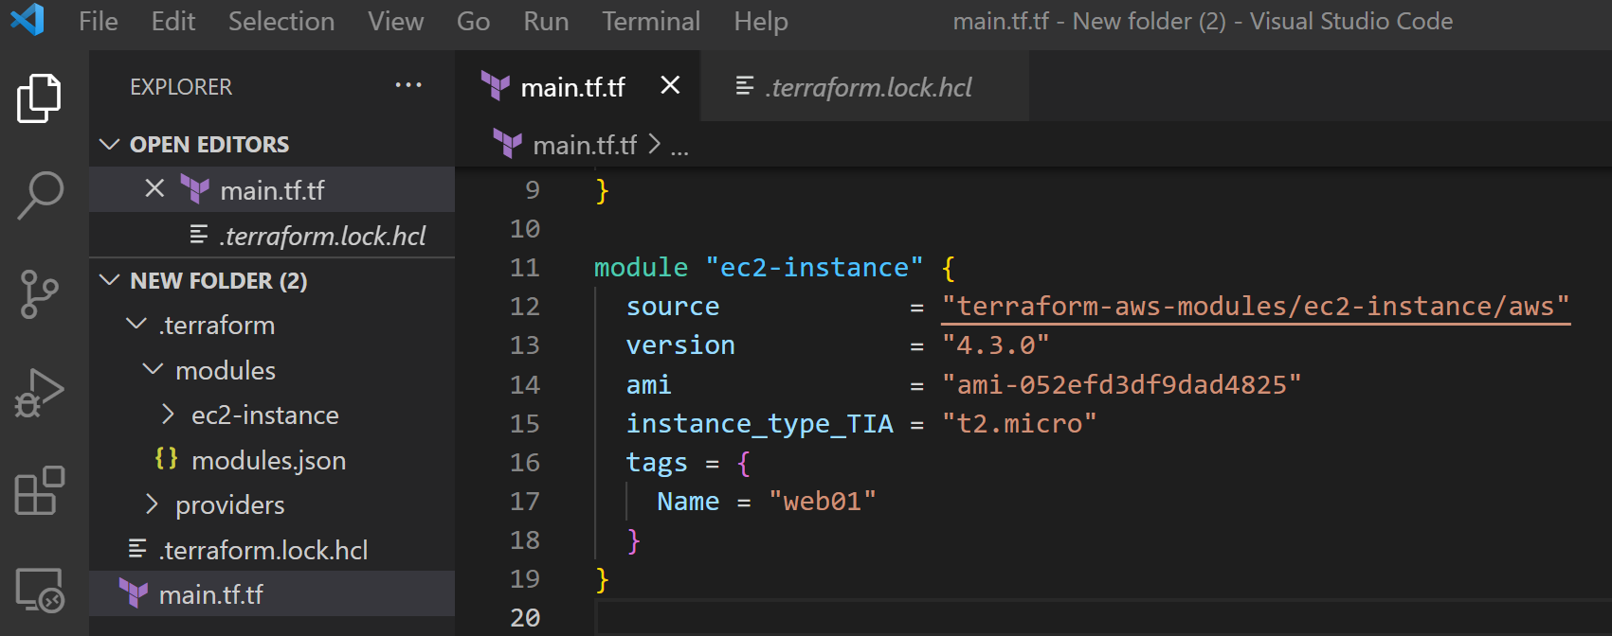
Terraform validate
Terraform fmt will automatically format your code. You can also enable this feature in VS code to automatically format your code when you save it.

Slide 74
Terraform plan
Terraform plan will check if you are allow to access AWS API first using the .aws directory where your AWS access and secret keys are stored
If you are allow to access AWS API, AMI will check if you have permission to create the resources that you want to create
If you have the permission to create the resource, Terraform will show what will be created
terraform {
required_version = ">= 1.0.0"
required_providers {
aws = {
source = "hashicorp/aws"
version = ">= 3.0"
}
}
}
module "ec2-instance" {
source = "terraform-aws-modules/ec2-instance/aws"
version = "4.3.0"
ami = "ami-052efd3df9dad4825"
instance_type = "t2.micro"
tags = {
Name = "web01"
}
}

Slide 75
Terraform apply
Terraform apply will check if you are allow to access AWS API first using the .aws directory where your AWS access and secret keys are stored
If you are allow to access AWS API, AMI will check if you have permission to create the resources that you want to create
If you have the permission to create the resource, Terraform will create the resource and record everything in the state file
terraform {
required_version = ">= 1.0.0"
required_providers {
aws = {
source = "hashicorp/aws"
version = ">= 3.0"
}
}
}
module "ec2-instance" {
source = "terraform-aws-modules/ec2-instance/aws"
version = "4.3.0"
ami = "ami-052efd3df9dad4825"
instance_type = "t2.micro"
tags = {
Name = "web01"
}
}

Slide 76
Terraform destroy
Terraform destroy will check if you are allow to access AWS API first using the .aws directory where your AWS access and secret keys are stored
If you are allow to access AWS API, AMI will check if you have permission to destroy the resources that you want to destroy the resource that you want to destroy
If you have the permission to destroy the resource, Terraform will destroy the resource remove it in the state file also
terraform {
required_version = ">= 1.0.0"
required_providers {
aws = {
source = "hashicorp/aws"
version = ">= 3.0"
}
}
}
module "ec2-instance" {
source = "terraform-aws-modules/ec2-instance/aws"
version = "4.3.0"
ami = "ami-052efd3df9dad4825"
instance_type = "t2.micro"
tags = {
Name = "web01"
}
}

Slide 77
Resource Deletion and Update In Terraform

Slide 78

provider "aws" {
region = "us-east-1"
}
module "ec2-instance" {
source = "terraform-aws-modules/ec2-instance/aws"
version = "4.3.0"
ami = "ami-052efd3df9dad4825"
instance_type = "t2.micro"
tags = {
Name = "web01"
}
}
variable "user_names" {
description = "IAM usernames"
type = list(string)
default = ["user1", "user2", "user3"]
}
resource "aws_iam_user" "user1" {
name = "user1"
}
resource "aws_iam_user" "user2" {
name = "user2"
}
resource "aws_iam_user" "user3" {
name = "user3"
}
How to Delete resources in Terraform?
Terraform destroy command
This command will remove everything from the state file
Please make sure that you want to destroy all the resources from the state file and in AWS before executing this command
You can get fire because of this command

Slide 79
provider "aws" {
region = "us-east-1"
}
module "ec2-instance" {
source = "terraform-aws-modules/ec2-instance/aws"
version = "4.3.0"
ami = "ami-052efd3df9dad4825"
instance_type = "t2.micro"
tags = {
Name = "web01"
}
}
variable "user_names" {
description = "IAM usernames"
type = list(string)
default = ["user1", "user2", "user3"]
}
resource "aws_iam_user" "user1" {
name = "user1"
}
resource "aws_iam_user" "user2" {
name = "user2"
}
resource "aws_iam_user" "user3" {
name = "user3"
}
How to Delete resources in Terraform?
We can Also comment out the resources in the TF file and run Terraform apply
Or we remove the resource completely from the TF files and run terraform apply if we will not need it again in the future
When you will run Terraform apply, the resource will be deleted from the state and in AWS

Slide 80
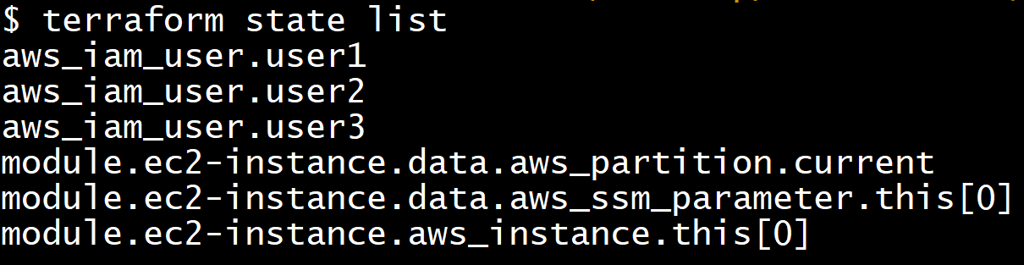
How to Delete resources in Terraform?
We can also target a specific resource and remove it from the state file if we do not want to comment out the resource run terraform apply.
This is useful sometime in the real world (WHY?)
When we target and delete the resource, we can now remove it from the TF files
terraform state list
terraform destroy --target=aws_iam_user.user1
terraform destroy --target=aws_iam_user.user1
terraform destroy --target=aws_iam_user.user3

Slide 81
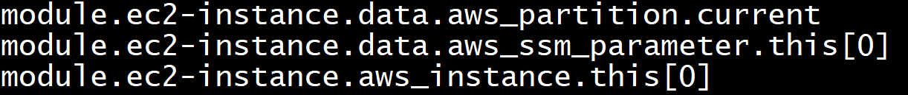
How to Delete resources in Terraform?
We can also just remove it from the state file and delete the resource manually in AWS. When we remove it from the state file, the resource will not be manage bt terraform anymore. Be very careful with this action
In this scenario, terraform apply will not help us.
This is useful sometime in the real world (WHY?)
terraform state list
terraform state rm aws_iam_user.user1
terraform state rm aws_iam_user.user1
terraform state rm aws_iam_user.user3

Slide 82
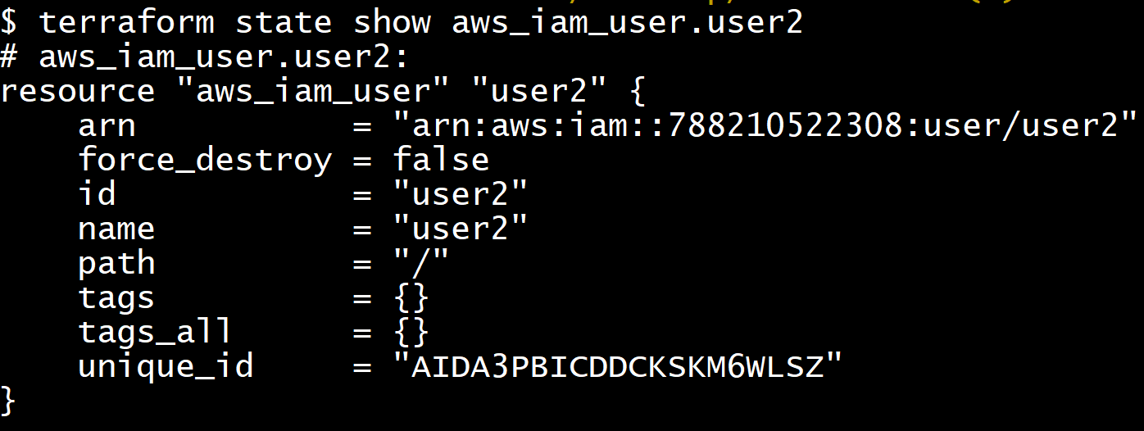
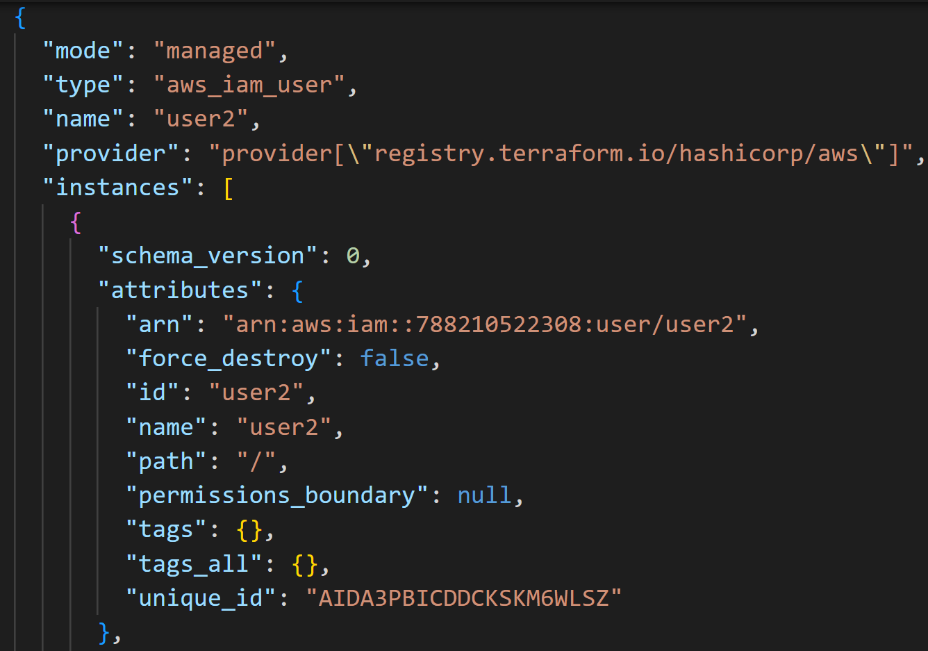
How to Delete resources in Terraform?
We can Also open the state file and remove the resource from the state file and delete it manually from AWS. This is helpful sometime when we have dependencies issue. Be very careful with this action
In this scenario, terraform apply will not help us.
This is useful sometime in the real world (WHY?)

Slide 83

How to Delete resources in Terraform?
In some scenarios, you will have to delete the state file and start over
When you delete the state file, all resources in AWS will not be manage anymore bt terraform and all resources have to be deleted manually.
This can happen sometime in the real world when the state is corrupted.
In this scenario, terraform apply will not help us.
This is useful sometime in the real world (WHY?)
This is a worst case scenario

Slide 84
Terraform Import

Slide 85
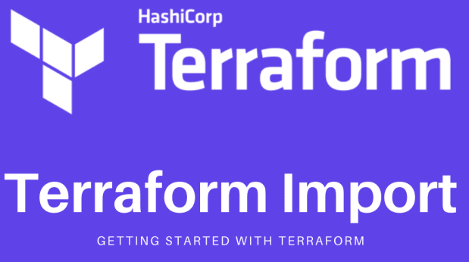
Importing Existing Infrastructure into Terraform
Terraform is a relatively new technology and adopting it to manage an organisation’s cloud resources might take some time and effort. The lack of human resources and the steep learning curve involved in using Terraform effectively causes teams to start using cloud infrastructure directly via their respective web consoles.
For that matter, any kind of IaC method (CloudFormation, Azure ARM templates, Pulumi, etc.) requires some training and real-time scenario handling experience. Things get especially complicated when dealing with concepts like states and remote backends. In a worst case scenario, you can lose the terraform.tfstate file. Luckily, you can use the import functionality to rebuild it.

Slide 86
Importing Existing Infrastructure into Terraform
Terraform Import
This is a simple command that will help us in this tricky situations, it is going to (as its name says) import existing infrastructure to be managed by Terraform from now on.
But be careful, there is an important thing to mention here, Terraform will not create the configuration file of the resource that was created manually.
Because of this, it is necessary to first write manually a resource configuration block for the resource (with the same properties as the one that is already created), to which the imported object will be linked.
The import command is very useful when a resource is created manually. This occurs very frequently 😅 fortunately exists this solution so don't hesitate to use it when it happens to you

Slide 87
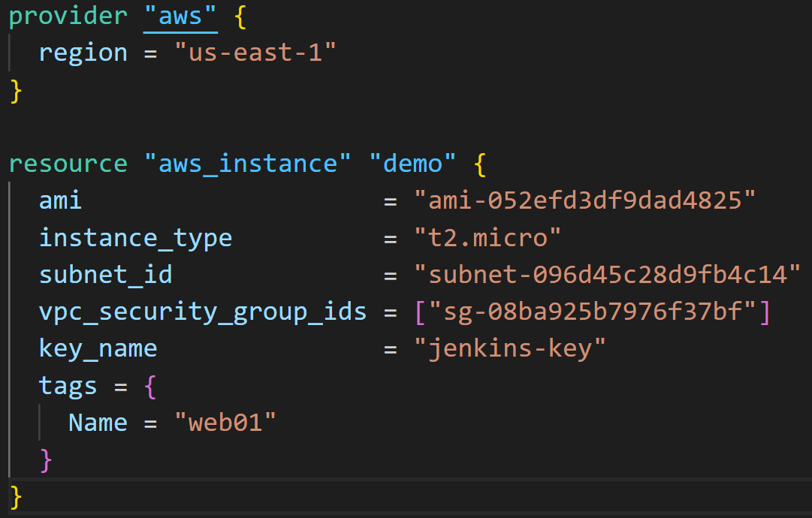
Importing Existing Infrastructure into Terraform
provider "aws" {
region = "us-east-1"
}
resource "aws_instance" "demo" {
ami = "ami-052efd3df9dad4825"
instance_type = "t2.micro"
subnet_id = "subnet-096d45c28d9fb4c14"
vpc_security_group_ids = ["sg-08ba925b7976f37bf"]
key_name = "jenkins-key"
tags = {
Name = "web01"
}
}
So let's do an example with an AWS EC2 instance:
Create a file with the provider configuration (in this case AWS).
Create a file in which we need to configure the resource that is already created in the Cloud with the same properties.
Run terraform import
terraform import aws_instance.demo [Running instance ID]
terraform import aws_instance.demo i-0c598199bf2771676

Slide 88
Importing Existing Infrastructure into Terraform
provider "aws" {
region = "us-east-1"
}
resource "aws_instance" "demo" {
ami = "ami-052efd3df9dad4825"
instance_type = "t2.micro"
subnet_id = "subnet-096d45c28d9fb4c14"
vpc_security_group_ids = ["sg-08ba925b7976f37bf"]
key_name = "jenkins-key"
tags = {
Name = "web01"
}
}
variable "user_names" {
description = "IAM usernames"
type = list(string)
default = ["user1", "user2", "user3"]
}
resource "aws_iam_user" "user1" {
name = var.user_names[0]
}
resource "aws_iam_user" "user2" {
name = var.user_names[1]
}
resource "aws_iam_user" "user3" {
name = var.user_names[2]
}
So let's do an example with an AWS EC2 instance and 3 IAM manually:
Create a file with the provider configuration (in this case AWS).
Create a file in which we need to configure the resource that is already created in the Cloud with the same properties.
Run terraform import
terraform import aws_instance.demo [Running instance ID]
terraform import aws_instance.demo i-0c598199bf2771676
terraform import aws_instance.user1 user1
terraform import aws_instance.user1 user2
terraform import aws_instance.user1 user3

Slide 89
Terraform TF Files

Slide 90
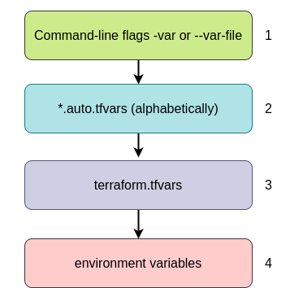
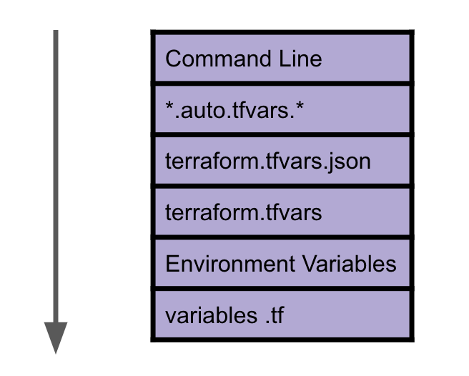

Slide 91
Terraform Blocks

Slide 92
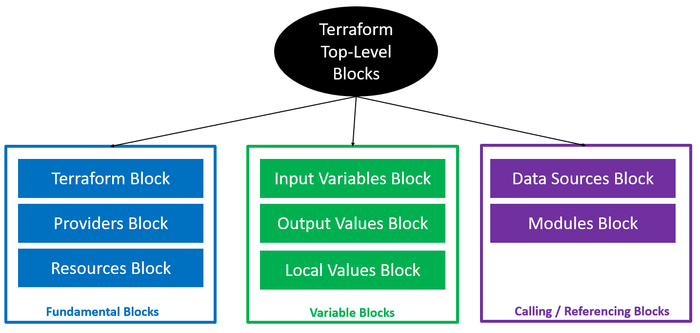
Terraform Provider Block

Slide 93
Terraform Provider Block
Terraform relies on plugins called "providers" to interact with cloud providers, SaaS providers, and other APIs. Terraform configurations must declare which providers they require so that Terraform can install and use them.
Providers are HEART of Terraform
Without Providers, Terraform cannot manage any infrastructure.
Providers are distributed separately from Terraform and each provider has its own release cycles and Version Numbers
Terraform Registry is publicly available which contains many Terraform Providers for most major Infra Platforms
provider "aws" {
region = "us-east-1"
}
provider "azurerm" {
features {}
}

Slide 94
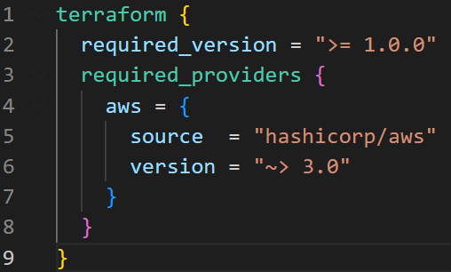
terraform {
required_version = ">= 1.0.0"
required_providers {
aws = {
source = "hashicorp/aws"
version = "~> 3.0"
}
google = {
source = "hashicorp/google"
version = "~> 3.76.0"
}
null = {
source = "hashicorp/null"
version = "~> 3.1.0"
}
azurerm = {
source = "hashicorp/azurerm"
version = "~> 2.69.0"
}
helm = {
source = "hashicorp/helm"
version = "~> 2.5"
}
kubernetes = {
source = "hashicorp/kubernetes"
version = "~> 2.11"
}
http = {
source = "hashicorp/http"
#version = "2.1.0"
version = "~> 2.1"
}
}
}
Terraform Definition Block
This block can be called in 3 ways. All means the same.
Terraform Block
Terraform Settings Block
Terraform Configuration Block
terraform {
required_version = ">= 1.0.0"
required_providers {
aws = {
source = "hashicorp/aws"
version = "~> 3.0"
}
}
}

Slide 95
Terraform Module Block
module "ec2_cluster" {
source = "terraform-aws-modules/ec2-instance/aws"
version = "~> 2.0"
name = "my-modules-demo"
instance_count = 2
ami = data.aws_ami.amzlinux.id
instance_type = "t2.micro"
key_name = "terraform-key"
monitoring = true
vpc_security_group_ids = ["sg-08b25c5a5bf489ffa"] # Get Default VPC Security Group ID and replace
subnet_id = "subnet-4ee95470" # Get one public subnet id from default vpc and replace
user_data = file("apache-install.sh")
tags = {
Terraform = "true"
Environment = "dev"
}
}

Slide 96
Terraform Backend Block
terraform {
backend "s3" {
bucket = "ektec-terraform-student-state"
key = "dev/dev-ec2/terraform.tfstate"
region = "us-east-1"
dynamodb_table = "ektec-terraform-student-state-lock"
}
}
terraform {
backend "s3" {
bucket = "del-terraform-state"
key = "aws-terraform/bamboo-agent/terraform.tfstate"
region = "us-east-1"
# dynamodb_table = "ektec-terraform-state-lock"
}
}

Slide 97
Terraform data Block
data "aws_ami" "amzlinux" {
most_recent = true
owners = ["amazon"]
filter {
name = "name"
values = ["amzn2-ami-hvm-*"]
}
filter {
name = "root-device-type"
values = ["ebs"]
}
filter {
name = "virtualization-type"
values = ["hvm"]
}
filter {
name = "architecture"
values = ["x86_64"]
}
}
module "ec2_cluster" {
source = "terraform-aws-modules/ec2-instance/aws"
version = "~> 2.0"
name = "my-modules-demo"
instance_count = 2
ami = data.aws_ami.amzlinux.id
instance_type = "t2.micro"
key_name = "terraform-key"
monitoring = true
vpc_security_group_ids = ["sg-08b25c5a5bf489ffa"]
subnet_id = "subnet-4ee95470"
tags = {
Terraform = "true"
Environment = "dev"
}
}

Slide 98
Terraform Module Block
data "aws_ami" "amzlinux" {
most_recent = true
owners = ["amazon"]
filter {
name = "name"
values = ["amzn2-ami-hvm-*"]
}
filter {
name = "root-device-type"
values = ["ebs"]
}
filter {
name = "virtualization-type"
values = ["hvm"]
}
filter {
name = "architecture"
values = ["x86_64"]
}
}
module "ec2_cluster" {
source = "terraform-aws-modules/ec2-instance/aws"
version = "~> 2.0"
name = "my-modules-demo"
instance_count = 2
ami = data.aws_ami.amzlinux.id
instance_type = "t2.micro"
key_name = "terraform-key"
monitoring = true
vpc_security_group_ids = ["sg-08b25c5a5bf489ffa"]
subnet_id = "subnet-4ee95470"
tags = {
Terraform = "true"
Environment = "dev"
}
}

Slide 99
Terraform output Block
# Resource Block
resource "aws_instance" "bamboo" {
ami = data.aws_ami.ubuntu.id
instance_type = local.instance_type
user_data = file("${path.module}/bamboo-user-data/bamboo-user-data.sh")
key_name = "jenkins-key"
subnet_id = local.subnet_id_a
tags = var.tags
}
# Resource Block
resource "aws_eip" "bamboo_eip" {
depends_on = [aws_instance.bamboo]
instance = aws_instance.bamboo.id
vpc = true
tags = local.tags
}
# bastion public
output "bamboo_public_ip" {
description = "List of IDs of instances"
value = aws_instance.bamboo.public_ip
}

Slide 100
Terraform output Block
# Resource Block
resource "aws_instance" "bamboo" {
ami = data.aws_ami.ubuntu.id
instance_type = local.instance_type
user_data = file("${path.module}/bamboo-user-data/bamboo-user-data.sh")
key_name = "jenkins-key"
subnet_id = local.subnet_id_a
tags = var.tags
}
# Resource Block
resource "aws_eip" "bamboo_eip" {
depends_on = [aws_instance.bamboo]
instance = aws_instance.bamboo.id
vpc = true
tags = local.tags
}
# bastion public
output "bamboo_public_ip" {
description = "List of IDs of instances"
value = aws_instance.bamboo.public_ip
}

Slide 101
## Local variables blocks
locals {
instance_type = "t2.micro"
vpc_id = "vpc-068852590ea4b093b"
subnet_id_a = "subnet-096d45c28d9fb4c14"
subnet_id_b = "subnet-05f285a35173783b0"
subnet_id_c = "subnet-0cf0e3c5a513134bd"
subnet_id_d = "subnet-0df29b31a59072845"
tags = {
Name = "dev-web-server"
Owner = "SRP"
Access-ID = "2645"
Project = "srp"
Environment = "dev"
Create_By = "Terraform"
}
}
# Resource Block
resource "aws_instance" "bamboo" {
ami = data.aws_ami.ubuntu.id
instance_type = local.instance_type
user_data = file("${path.module}/bamboo-user-data/bamboo-user-data.sh")
key_name = "jenkins-key"
subnet_id = local.subnet_id_a
tags = var.tags
}
Terraform Local Variable Block
# Resource Block
resource "aws_eip" "bamboo_eip" {
depends_on = [aws_instance.bamboo]
instance = aws_instance.bamboo.id
vpc = true
tags = local.tags
}

Slide 102
## Local variables blocks
locals {
instance_type = "t2.micro"
vpc_id = "vpc-068852590ea4b093b"
subnet_id_a = "subnet-096d45c28d9fb4c14"
subnet_id_b = "subnet-05f285a35173783b0"
subnet_id_c = "subnet-0cf0e3c5a513134bd"
subnet_id_d = "subnet-0df29b31a59072845"
tags = {
Name = "dev-web-server"
Owner = "SRP"
Access-ID = "2645"
Project = "srp"
Environment = "dev"
Create_By = "Terraform"
}
}
# Resource Block
resource "aws_instance" "bamboo" {
ami = data.aws_ami.ubuntu.id
instance_type = local.instance_type
user_data = file("${path.module}/bamboo-user-data/bamboo-user-data.sh")
key_name = "jenkins-key"
subnet_id = local.subnet_id_a
tags = var.tags
}
Terraform Null Resource Block
## Null resource block
resource "null_resource" "copy_ec2_keys" {
depends_on = [aws_instance.bamboo]
connection {
type = "ssh"
host = aws_eip.bamboo_eip.public_ip
user = "ubuntu"
password = ""
private_key = file("private-key/terraform-key.pem")
}

Slide 103
## Local variables blocks
locals {
instance_type = "t2.micro"
vpc_id = "vpc-068852590ea4b093b"
subnet_id_a = "subnet-096d45c28d9fb4c14"
subnet_id_b = "subnet-05f285a35173783b0"
subnet_id_c = "subnet-0cf0e3c5a513134bd"
subnet_id_d = "subnet-0df29b31a59072845"
tags = {
Name = "dev-web-server"
Owner = "SRP"
Access-ID = "2645"
Project = "srp"
Environment = "dev"
Create_By = "Terraform"
}
}
# Resource Block
resource "aws_instance" "bamboo" {
ami = data.aws_ami.ubuntu.id
instance_type = local.instance_type
user_data = file("${path.module}/bamboo-user-data/bamboo-user-data.sh")
key_name = "jenkins-key"
subnet_id = local.subnet_id_a
tags = var.tags
}
Terraform Null Resource Block
## provisioner block
provisioner "file" {
source = "bamboo-user-data/bamboo-user-data.sh"
destination = "/tmp/bamboo-user-data.sh"
}
## provisioner block
provisioner "remote-exec" {
inline = [
"sudo chmod 400 /tmp/bamboo-user-data.sh",
"sudo bash /tmp/bamboo-user-data.sh"
]
}
}

Slide 104
## Local variables blocks
locals {
instance_type = "t2.micro"
vpc_id = "vpc-068852590ea4b093b"
subnet_id_a = "subnet-096d45c28d9fb4c14"
subnet_id_b = "subnet-05f285a35173783b0"
subnet_id_c = "subnet-0cf0e3c5a513134bd"
subnet_id_d = "subnet-0df29b31a59072845"
tags = {
Name = "dev-web-server"
Owner = "SRP"
Access-ID = "2645"
Project = "srp"
Environment = "dev"
Create_By = "Terraform"
}
}
# Resource Block
resource "aws_instance" "bamboo" {
ami = data.aws_ami.ubuntu.id
instance_type = local.instance_type
user_data = file("${path.module}/bamboo-user-data/bamboo-user-data.sh")
key_name = "jenkins-key"
subnet_id = local.subnet_id_a
tags = var.tags
}
Terraform Variable Block
## Variables block
variable "tags" {
type = map(string)
default = {
Name = "dev-web-server"
Owner = "SRP"
Access-ID = "2645"
Project = "srp"
Environment = "dev"
Create_By = "Terraform"
}
}
## Variables block
variable "aws_region" {
type = string
default = "us-east-1"
}

Slide 105
Terraform Workflow

Slide 106
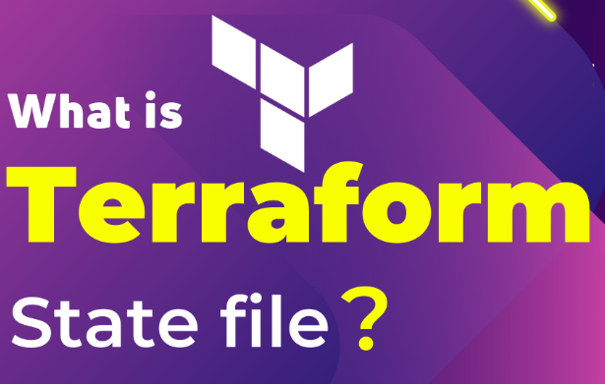
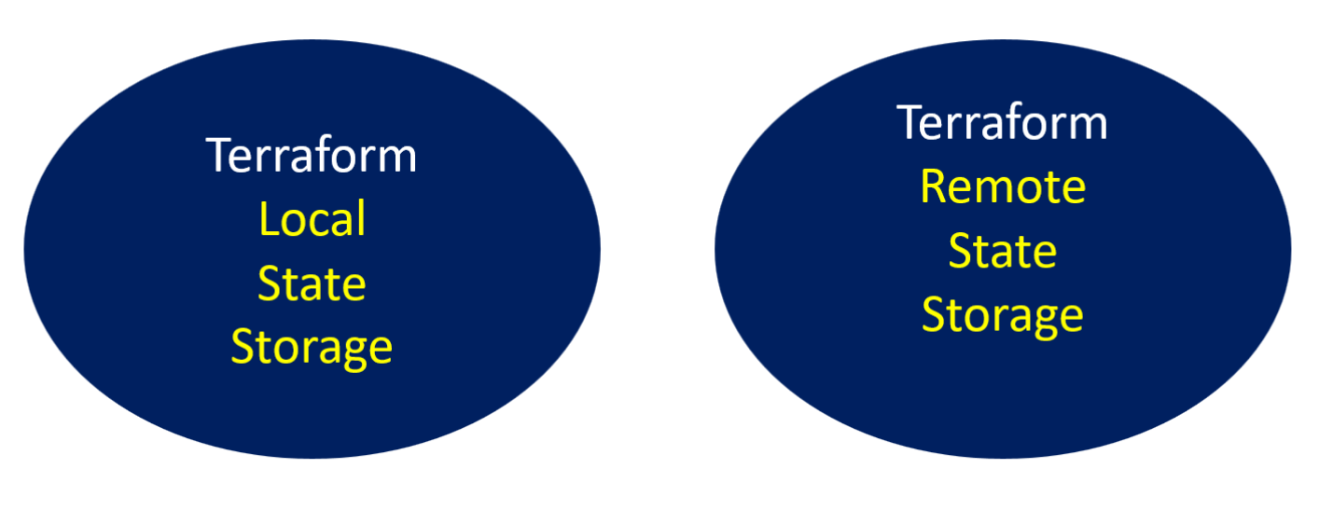
Terraform state file
When you run terraform apply command to create an infrastructure on cloud, Terraform creates a state file called “terraform.tfstate”. This State File contains full details of resources in our terraform code. When you modify something on your code and apply it on cloud, terraform will look into the state file, and compare the changes made in the code from that state file and the changes to the infrastructure based on the state file.
There is also a backup of the previous state in terraform.tfstate.backup
Terraform uses this local state to create plans and make changes to your infrastructure. Prior to any operation, Terraform does a refresh to update the state with the real infrastructure.
This state is stored by default in a local file named "terraform.tfstate", but it can also be stored remotely, which works better in a team environment.

Slide 107
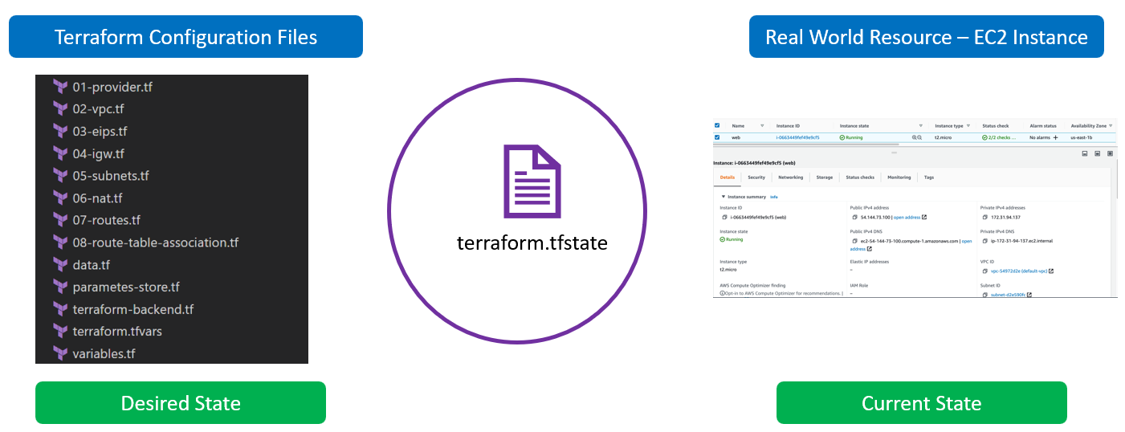
Current Vs Desired State
Current State = Current Infrastructure Resource in the cloud
Desired State = Infrastructure Configuration defined within the Terraform TF Files.
Terraform will always make sure the desired state matches with the current state

Slide 108
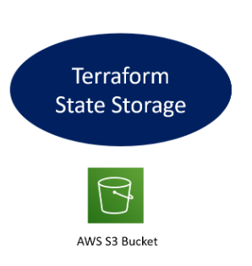
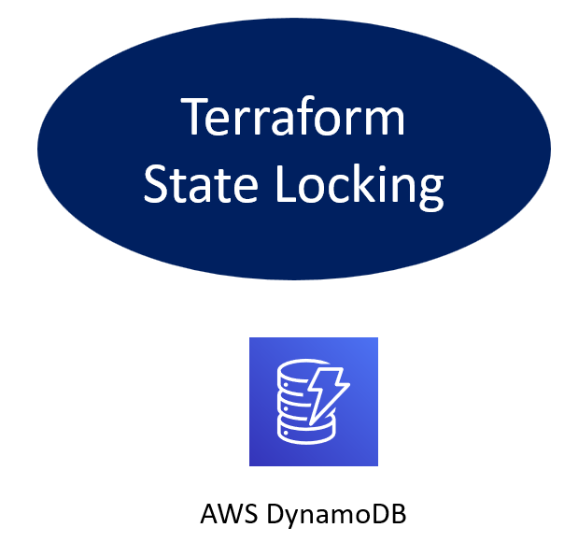
Terraform State Backend
Terraform backend is like the repository of instruction to load and run the terraform state especially when the operation like terraform applies executed. Backend is very important when you are developing the infrastructure with a big team. So, Understanding the Terraform Backend is very important
Terraform backend do 2 things:
It store the state file
And It look the state file
State Locking is to prevent conflicts and inconsistencies when the operations are being performed
Operations refers to performing API requests against infrastructure services in order to create, read, update, or destroy resources. Not every terraform subcommand performs API operations; many of them only operate on state data. Terraform apply and destroy will perform the backend state operations for instance.

Slide 109
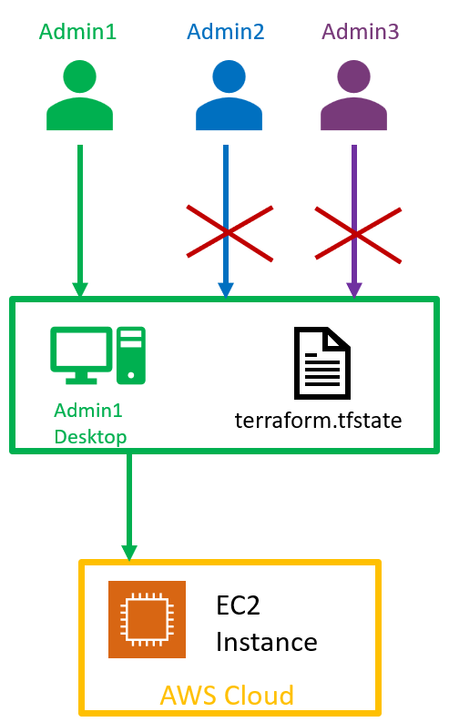
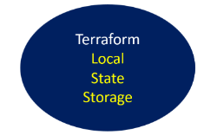
Terraform Local State File
Multiple Team members cannot update the infrastructure as they don’t have access to State File
Only the team member that have access to the state file can run terraform
This means we need store the state file in a shared location
Terraform apply and destroy will perform the backend state operations for instance.

Slide 110
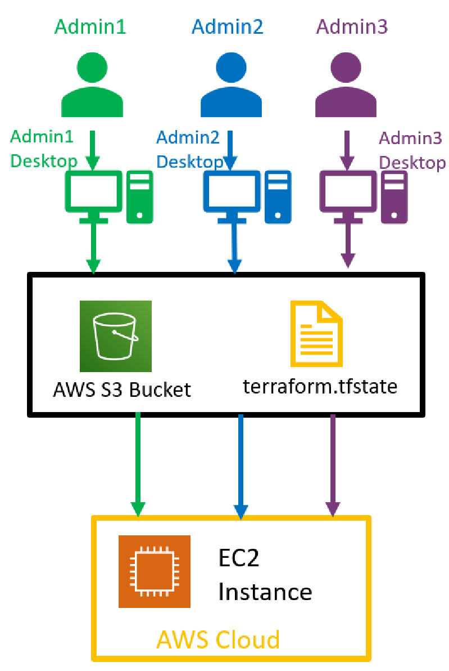
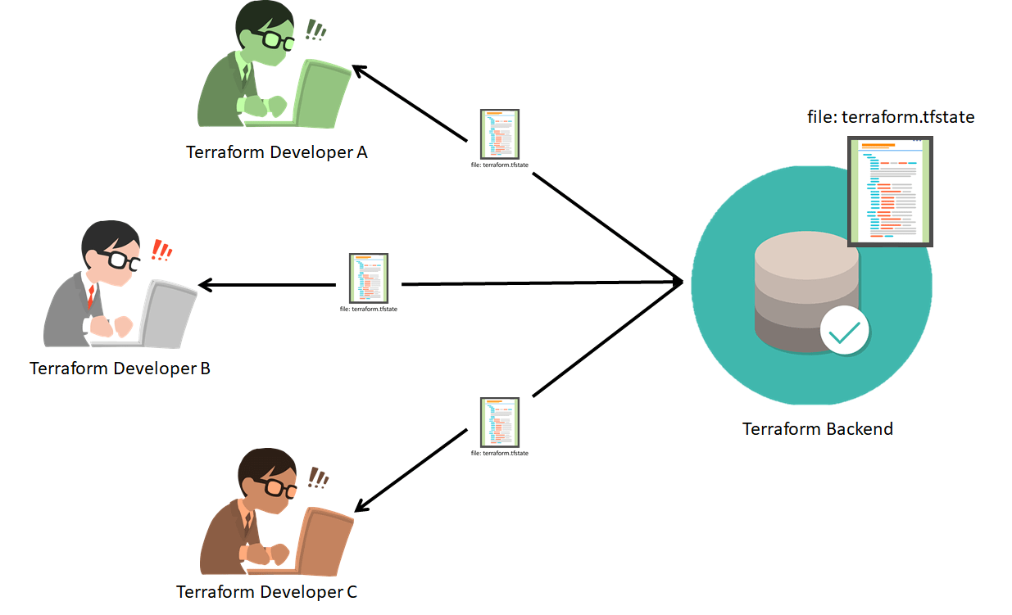
Terraform Remote State File
Multiple Team members can update the infrastructure as they there have access to State File
Every team member that have access to the state file can run terraform
This actually create another issue because the state file can be corrupted when 2 developers run terraform apply at the same time.
We need to implement a state lock

Slide 111
Terraform Remote State File
Multiple Team members can update the infrastructure as they there have access to State File
Every team member that have access to the state file can run terraform
This actually create another issue because the state file can be corrupted when 2 developers run terraform apply at the same time.
We need to implement a state lock

Slide 112
Terraform Commands

Slide 113
Terraform Commands
Option | Description
terraform version | Displays the version of Terraform installed
terraform fmt | Format Terraform configuration files. Both configuration files (.tf) and variable files (.tfvars) are updated.
terraform validate | Validates the configuration files for errors. It refers only to the configuration and not accessing any remote services such as remote state, or provider APIs.
terraform init | Initialize directory, pull down providers
terraform apply | Creates or updates infrastructure according to Terraform configuration files in the current directory.
terraform apply --auto-approve | apply changes without being prompted to enter “yes”
terraform plan -out plan.out | Output the deployment plan to plan.out
terraform apply plan.out | Use the plan.out plan file to deploy infrastructure
terraform plan -destroy | Outputs a destroy plan

Slide 114
Terraform Commands
Option | Description
terraform plan -destroy --target aws_iam_user.user1 | Plan destroy for a specific resource
terraform destroy --target aws_iam_user.user1 | Destroy a specify resource
terraform plan --target aws_iam_user.user1 | Plan for a specific resource
terraform apply --target aws_iam_user.user1 | Only apply/deploy changes to the targeted resource
terraform apply -var db-password=us-east-1 | Pass a variable via command-line while applying a configuration
terraform apply -var-file=prod.tfvars | Terraform will automatically loads all files which match terraform.tfvars or *.tfvars or .auto.tfvars from the current directory. Other files can be passed explicitly using -var-file flag
terraform plan -destroy -var-file=prod.tfvars --target aws_iam_user.user1 | Plan destroy with a specify vars file for a specific resource
terraform plan -var-file=prod.tfvars --target aws_iam_user.user1 | Plan with a specify vars file for a specific resource
terraform apply -var-file=prod.tfvars --target aws_iam_user.user1 | apply with a specify vars file for a specific resource

Slide 115
Terraform Commands
Option | Description
terraform state list | List all resources in the state file
terraform state rm aws_iam_user.user2 | Delete a resource from the state file
terraform state show aws_iam_user.user2 | Show details stored in Terraform state for the resource
terraform state pull | Pull the current state file and output to your screen
terraform state pull > state terraform state pull > terraform.tfstate | Pull the current state file and redirect the output to a file
terraform force-unlock LOCK_ID | force-unlock command requires a unique lock ID. Terraform will output the unique lock ID on the screen
terraform plan -target module.ec2-instance.aws_instance.my-instance | Plan for a specify module
terraform apply -target module.ec2-instance.aws_instance.my-instance | Apply a specify module
terraform apply -target module.ec2-instance.aws_instance.my-instance | Destroy a specify module

Slide 116
Terraform Commands
Option | Description
terraform taint [resource_name] terraform taint aws_iam_user.user2 | The terraform taint command manually marks Terraform managed resource as tainted, forcing it to be destroyed and recreated on the next apply
terraform untaint [resource_name] terraform untaint aws_security_group.allow_all | Delete a resource from the state file
terraform login | Obtain and save API token for Terraform cloud
terraform logout | Log out of Terraform Cloud
terraform output | List all outputs as stated in code
terraform output instance_public_ip | List out a specific declared output
terraform import aws_instance.new_ec2_instance i-abcd1234 | import EC2 instance with id i-abcd1234 into the Terraform resource named “new_ec2_instance” of type “aws_instance”

Slide 117
Terraform Commands
Option | Description
terraform providers | get information about providers used in current configuration
terraform apply -lock=true | Lock the state file so it can’t be modified by any other Terraform apply or modification action(possible only where backend allows locking)
terraform apply -lock=false | Do not lock the state file
terraform workspace list | List workspaces
terraform workspace show | Show the name of the current workspace
terraform workspace new [workspace_name] terraform workspace new dev | Create a new workspace
terraform workspace select [workspace_name] terraform workspace select default | Select a workspace
terraform workspace delete [workspace_name] terraform workspace select dev | Delete a workspace

Slide 118
Terragrunt commands
Option | Description
terragrunt plan | plan from each module or directory
terragrunt apply terragrunt apply --terragrunt-non-interactive | Apply from each module or directory
terragrunt destroy terragrunt destroy --terragrunt-non-interactive | Destroy from each module or directory
terragrunt plan-all | Plan from the root module
terragrunt apply-all terragrunt apply-all --terragrunt-non-interactive | Apply from the root module
terragrunt destroy-all terragrunt destroy-all --terragrunt-non-interactive | Destroy from the root module

Slide 119
Terraform Workspace

Slide 120
Terraform Workspace
When we create cloud resources using Terraform configuration language, the resources are known to be created in the default workspace. Workspace is a way to maintain multiple copies of deployments that can be created and destroyed
prod.tfvars
variable "region" {
type = string
}
variable "ami" {
type = string
}
variable "instance_type" {
type = string
default = "t2.micro"
}
variables.tf
variable "region" {
type = string
}
variable "ami" {
type = string
}
variable "instance_type" {
type = string
default = "t2.micro"
}
# dev.tfvars
region = "us-west-2"
instance_type = "t2.micro"
ami = "ami-003634241a8fcdec0"
prod.tfvars
region = "us-east-1"
instance_type = "t2.large"
ami = "ami-085925f297f89fce1"

Slide 121
Terraform Workspace
# main.tf
provider "aws" {
region = var.region
}
locals {
name = "${terraform.workspace}-instance"
}
resource "aws_instance" "main" {
ami = var.ami
instance_type = var.instance_type
tags = {
Name = local.name
}
}
terraform workspace new dev
terraform workspace new create prod
terraform workspace select create dev
terraform init
terraform plan -var-file=prod.tfvars
terraform apply -var-file=prod.tfvars
terraform destroy -var-file=prod.tfvars
terraform workspace select create prod
terraform init
terraform plan -var-file=prod.tfvars
terraform apply -var-file=prod.tfvars
terraform destroy -var-file=prod.tfvars

Slide 122
Deploying in Multiple Environments

Slide 123
Deploy In Multiple Environments
[default]
aws_access_key_id =
aws_secret_access_key =
[dev]
aws_access_key_id =
aws_secret_access_key =
[prod]
aws_access_key_id =
aws_secret_access_key =
[stg]
aws_access_key_id =
aws_secret_access_key =
[qa]
aws_access_key_id =
aws_secret_access_key =
Configure your credential file
Create access keys and secret access keys for each environment
Add the keys in the credential

Slide 124
Deploy In Multiple Environments
[default]
region = us-west-2
output = json
[profile dev]
region = us-west-2
output = json
[profile qa]
region = us-west-2
output = json
[profile stg]
region = us-west-2
output = json
[profile prod]
region = us-east-1
output = json
Configure your config file
Add all region for each environment in your config file

Slide 125
Deploy In Multiple Environments
export AWS_PROFILE=default
echo $AWS_PROFILE
aws s3 ls
export AWS_PROFILE=dev
echo $AWS_PROFILE
aws s3 ls
export AWS_PROFILE=qa
echo $AWS_PROFILE
aws s3 ls
export AWS_PROFILE=stg
echo $AWS_PROFILE
aws s3 ls
export AWS_PROFILE=prod
echo $AWS_PROFILE
aws s3 ls
Test if our environment is working as expected
List buckets in all environments using the AWS profile
aws s3 ls
aws s3 ls --profile dev
aws s3 ls --profile prod
aws s3 ls --profile qa
aws s3 ls --profile stg

Slide 126
Deploy In Multiple Environments
terraform plan
terraform plan --profile dev
terraform plan --profile prod
terraform plan --profile qa
terraform plan --profile stg
terraform {
required_version = ">= 1.0.0"
required_providers {
aws = {
source = "hashicorp/aws"
version = ">= 3.0"
}
}
}
module "ec2-instance" {
source = "terraform-aws-modules/ec2-instance/aws"
version = "4.3.0"
ami = "ami-052efd3df9dad4825"
instance_type = "t2.micro"
tags = {
Name = "web01"
}
}
terraform apply
terraform apply --profile dev
terraform apply --profile prod
terraform apply --profile qa
terraform apply --profile stg
terraform destroy
terraform destroy --profile dev
terraform destroy --profile prod
terraform destroy --profile qa
terraform destroy --profile stg

Slide 127
Deploy In Multiple Environments
terraform {
required_version = ">= 1.0.0"
required_providers {
aws = {
source = "hashicorp/aws"
version = ">= 3.0"
}
}
}
module "ec2-instance" {
source = "terraform-aws-modules/ec2-instance/aws"
version = "4.3.0"
ami = "ami-052efd3df9dad4825"
instance_type = "t2.micro"
tags = {
Name = "web01"
}
}
export AWS_PROFILE=default
echo $AWS_PROFILE
terraform plan
terraform apply
terraform destroy

Slide 128
Deploy In Multiple Environments
terraform {
required_version = ">= 1.0.0"
required_providers {
aws = {
source = "hashicorp/aws"
version = ">= 3.0"
}
}
}
module "ec2-instance" {
source = "terraform-aws-modules/ec2-instance/aws"
version = "4.3.0"
ami = "ami-052efd3df9dad4825"
instance_type = "t2.micro"
tags = {
Name = "web01"
}
}
Deploying to dev
export AWS_PROFILE=dev
echo $AWS_PROFILE
terraform plan
terraform apply
terraform destroy

Slide 129
Deploy In Multiple Environments
terraform {
required_version = ">= 1.0.0"
required_providers {
aws = {
source = "hashicorp/aws"
version = ">= 3.0"
}
}
}
module "ec2-instance" {
source = "terraform-aws-modules/ec2-instance/aws"
version = "4.3.0"
ami = "ami-052efd3df9dad4825"
instance_type = "t2.micro"
tags = {
Name = "web01"
}
}
Deploying to qa
export AWS_PROFILE=qa
echo $AWS_PROFILE
terraform plan
terraform apply
terraform destroy

Slide 130
Deploy In Multiple Environments
terraform {
required_version = ">= 1.0.0"
required_providers {
aws = {
source = "hashicorp/aws"
version = ">= 3.0"
}
}
}
module "ec2-instance" {
source = "terraform-aws-modules/ec2-instance/aws"
version = "4.3.0"
ami = "ami-052efd3df9dad4825"
instance_type = "t2.micro"
tags = {
Name = "web01"
}
}
Deploying to stg
export AWS_PROFILE=stg
echo $AWS_PROFILE
terraform plan
terraform apply
terraform destroy

Slide 131
Deploy In Multiple Environments
terraform {
required_version = ">= 1.0.0"
required_providers {
aws = {
source = "hashicorp/aws"
version = ">= 3.0"
}
}
}
module "ec2-instance" {
source = "terraform-aws-modules/ec2-instance/aws"
version = "4.3.0"
ami = "ami-052efd3df9dad4825"
instance_type = "t2.micro"
tags = {
Name = "web01"
}
}
Deploying to prod
export AWS_PROFILE=prod
echo $AWS_PROFILE
terraform plan
terraform apply
terraform destroy

Slide 132
Others

Slide 133
Terraform Tips
variable "common_tags" {
type = map(any)
default = {
"AssetID" = "2560"
"AssetName" = "Insfrastructure"
"Environment" = "dev"
"Project" = "alpha"
"CreateBy" = "Terraform"
"cloudProvider" = "aws"
}
}
tags = merge(var.common_tags, {
Name = format("%s-%s-%s-vpc", var.common_tags["AssetID"], var.common_tags["Environment"], var.common_tags["Project"])
}
Name = 2560-dev-alpha-vpc

Slide 134
Terraform Tips
variable "common_tags" {
type = map(any)
default = {
"AssetID" = "2560"
"AssetName" = "Insfrastructure"
"Environment" = "dev"
"Project" = "alpha"
"CreateBy" = "Terraform"
"cloudProvider" = "aws"
}
}
tags = merge(var.common_tags, {
Name = format("%s-%s-%s-vpc-private-subnet-db-02", var.common_tags["AssetID"], var.common_tags["Environment"], var.common_tags["Project"])
}
Name = 2560-dev-alpha-vpc-private-subnet-db-02

Slide 135
Terraform Tips
data "aws_region" "current" {}
data "aws_caller_identity" "current" {}
variable "tags" {
type = map(any)
default = {
environment = "dev"
project-id = "2542"
}
}
bucket = format("%s-repository-%s-%s-%s", var.tags["environment"], var.tags["project-id"], data.aws_region.current.name, data.aws_caller_identity.current.account_id)
Name = mam-dev-repository-2542-us-east-1-788210522308

Slide 136
Terraform Tips
variable "vpc_prefix" {
type = string
default = "/2560/adl/vpc"
}
resource "aws_ssm_parameter" "vpc-private-and-public-subnet-ids" {
name = join("/", ["${var.vpc_prefix}", "vpc-private-and-public-subnet-ids"])
tags = var.common_tags
}
name = /2560/adl/vpc/vpc-private-and-public-subnet-ids

Slide 137
Terraform Tips
variable "common_tags" {
type = map(any)
default = {
"AssetID" = "2560"
"AssetName" = "Insfrastructure"
"Environment" = "dev"
"Project" = "alpha"
"CreateBy" = "Terraform"
"cloudProvider" = "aws"
}
}
tags = merge(var.common_tags, {
Name = format("%s-%s-%s-vpc", var.common_tags["AssetID"], var.common_tags["Environment"], var.common_tags["Project"])
}
Name = 2560-dev-alpha-vpc

Slide 138
Terraform Tips
variable "tags" {
type = map(string)
default = {
environment = "prod-mam"
}
}
description = "Password for ${var.tags["environment"]} RDS"
name = format("zedcloud-benthos-%s-os", var.environment)
VantaDescription = format("Benthos node for %s cluster", var.environment)
Cost = var.prod ? "production" : "engineering"

Slide 139
provider "aws" {
region = var.aws_region
}
resource "aws_instance" "myec2" {
instance_type = "t2.micro"
ami = lookup(var.aws_amis , var.aws_region)
count = 1
}
variable "aws_region" {
type = string
default = "us-east-1"
}
variable "aws_amis" {
type = map(string)
default = {
us-east-1 = "ami-04d29b6f966df1537"
us-west-1 = "ami-08d9a394ac1c2994c"
us-east-2 = "ami-09558250a3419e7d0"
}
}
Terraform Tips

Slide 140
provider "aws" {
region = var.aws_region
}
resource "aws_instance" "myec2" {
instance_type = "t2.micro"
ami = lookup(var.aws_amis , var.aws_region)
count = 1
}
variable "aws_region" {
type = string
default = "us-east-1"
}
variable "aws_amis" {
type = map(string)
default = {
us-east-1 = "ami-04d29b6f966df1537"
us-west-1 = "ami-08d9a394ac1c2994c"
us-east-2 = "ami-09558250a3419e7d0"
}
}
Terraform Tips
provider "aws" {
region = "us-east-1"
}
resource "aws_instance" "web" {
ami = var.ec2["ami"]
instance_type = var.ec2["instance_type"]
count = var.ec2["count"]
availability_zone = var.ec2["availability_zone"]
key_name = var.ec2["key_name"]
tags = {
Name = "Dev"
}
}
variable "ec2" {
description = "The map of properties for ec2 to override defaults"
type = map(string)
default = {
ami = "ami-04d29b6f966df1537"
instance_type = "t2.micro"
count = "2"
availability_zone = "us-east-1a"
key_name = "jenkins-key"
}
}

Slide 141
Terraform Tips
provider "aws" {
region = "us-east-1"
}
variable "aws_instance" {
type = map(any)
description = "Map of RDS Instances and their values"
default = {
ami = "ami-052efd3df9dad4825"
instance_type = "t2.micro"
}
}
module "ec2-instance" {
source = "terraform-aws-modules/ec2-instance/aws"
version = "4.3.0"
for_each = var.aws_instance
ami = lookup(var.aws_instance, "ami", "null")
instance_type = lookup(var.aws_instance, "instance_type", "t2.small")
tags = {
Name = "web01"
}
}

Slide 142
Terraform Tips
locals {
instance_type = "21"
aws_instance = lookup(yamldecode(file("./variable.yaml"))["dev"], "aws_instance", {})
common_tags = {
owner = "Alpha"
project = "sre"
environment = "dev"
application = "sre-dev"
terraform = "tree"
}
}
provider "aws" {
region = "us-east-1"
}
output "name1" {
value = local.common_tags
}
output "name2" {
value = local.aws_instance
}
module "ec2-instance" {
source = "terraform-aws-modules/ec2-instance/aws"
version = "4.3.0"
ami = lookup(local.aws_instance, "ami", "null")
instance_type = lookup(local.aws_instance, "instance_type", "t2.small")
tags = local.common_tags
}
## variable.yaml
dev:
aws_instance:
ami: ami-052efd3df9dad4825
instance_type: t2.micro

Slide 143
Terraform Tips
locals {
aws_instance = lookup(yamldecode(file("./variable.yaml"))["dev"], "aws_instance", {})
common_tags = lookup(yamldecode(file("./variable.yaml"))["dev"]["aws_instance"], "tags", {})
}
provider "aws" {
region = lookup(local.aws_instance, "region", "null")
}
output "name1" {
value = local.common_tags
}
output "name2" {
value = local.aws_instance
}
module "ec2-instance" {
source = "terraform-aws-modules/ec2-instance/aws"
version = "4.3.0"
ami = lookup(local.aws_instance, "ami", "null")
instance_type = lookup(local.aws_instance, "instance_type", "t2.small")
tags = local.common_tags
}
## variable.yaml
dev:
aws_instance:
region: us-east-1
ami: ami-052efd3df9dad4825
instance_type: t2.micro
tags:
project: sre
environment: dev
application: sre-dev
terraform: tree

Slide 144
Terraform Tips
locals {
aws_instance = lookup(yamldecode(file("./variable.yaml"))["dev"], "aws_instance", {})
common_tags = lookup(yamldecode(file("./variable.yaml"))["dev"]["aws_instance"], "tags", {})
}
provider "aws" {
region = lookup(local.aws_instance, "region", "null")
}
output "name1" {
value = local.common_tags
}
output "name2" {
value = local.aws_instance
}
module "ec2-instance" {
source = "terraform-aws-modules/ec2-instance/aws"
version = "4.3.0"
ami = lookup(local.aws_instance, "ami", "null")
instance_type = lookup(local.aws_instance, "instance_type", "t2.small")
tags = {
Name = format("%s-%s-web", lookup(local.common_tags, "environment", "null"), lookup(local.common_tags, "project", "null"))
project = lookup(local.common_tags, "project", "null")
environment = lookup(local.common_tags, "environment", "null")
Create_by = lookup(local.common_tags, "terraform", "Terraform")
}
}
## variable.yaml
dev:
aws_instance:
region: us-east-1
ami: ami-052efd3df9dad4825
instance_type: t2.micro
tags:
project: sre
environment: dev
application: sre-dev
terraform: tree

Slide 145
Terraform Tips
resource "aws_instance" "web" {
subnet = "${var.env == "production" ? var.prod_subnet : var.dev_subnet}"
}
resource "aws_instance" "vpn" {
count = "${var.something ? 1 : 0}"
}
variable "blue_node_color" {
type = string
default = "blue"
}
variable "green_node_color" {
type = string
default = "green"
}
variable "node_min" {
type = string
default = "1"
}
variable "desired_node" {
type = string
default = "1"
}
variable "blue" {
type = bool
default = true
}
variable "green" {
type = bool
default = false
}
scaling_config {
desired_size = var.green_node_color == "green" && var.green ? var.desired_node : 0
min_size = var.green_node_color == "green" && var.green ? var.node_min : 0
max_size = var.green_node_color == "green" && var.green ? var.node_max : var.node_max
}

Slide 146
Terraform Modules

Slide 147
Terraform Module
A Terraform module is a collection of standard configuration files in a dedicated directory. Terraform modules encapsulate groups of resources dedicated to one task, reducing the amount of code you have to develop for similar infrastructure components.
ref=development: we are refer to the development branch
source = "../../terraform/ec2/"
source = "github.com/leonardtia1/test-module/terraform/ec2"
source = "git::https://github.com/leonardtia1/test-module.git"
source = "git::https://github.com/leonardtia1/test-module.git?ref=development"
source = "git::ssh://github.com/leonardtia1/test-module.git"
source = "terraform-aws-modules/vpc/aws"

Slide 148
Terraform Module
AWS aurora module
ECR module
Fargate profile module
AWS secret manager module
AWS parameter store module
We will create:
VPC module
EKS module
S3 module
EC2 module
acm module
postgres module
mysql module

Slide 149
Terraform Module
module "vpc" {
source = "terraform-aws-modules/vpc/aws"
name = "my-vpc"
cidr = "10.0.0.0/16"
azs = ["us-east-1a", "us-east-1b"]
private_subnets = ["10.0.1.0/24", "10.0.2.0/24"]
public_subnets = ["10.0.3.0/24", "10.0.4.0/24"]
database_subnets = ["10.0.5.0/24", "10.0.6.0/24"]
enable_nat_gateway = true
single_nat_gateway = false
tags = {
Terraform = "true"
Environment = "dev"
}
}
Referring a VPC module from AWS

Slide 150
Referring a VPC module from local
Terraform Module
module "vpc-dev" {
source = "../../../modules/vpc"
aws_region = var.aws_region
cidr_block = var.cidr_block
private_subnets_eks_ec2 = var.private_subnets_eks_ec2
private_subnets_db = var.private_subnets_db
public = var.public
aws_availability_zones = var.aws_availability_zones
instance_tenancy = var.instance_tenancy
enable_dns_support = var.enable_dns_support
enable_dns_hostnames = var.enable_dns_hostnames
enable_classiclink = var.enable_classiclink
enable_classiclink_dns_support = var.enable_classiclink_dns_support
assign_generated_ipv6_cidr_block = var.assign_generated_ipv6_cidr_block
cluster_name = var.cluster_name
}

Slide 151
VPC module terraform.tfvars
Terraform Module
locals {
aws_region = "us-east-1"
cidr_block = "10.0.0.0/16"
instance_tenancy = "default"
enable_dns_support = true
enable_dns_hostnames = true
enable_classiclink = false
enable_classiclink_dns_support = false
assign_generated_ipv6_cidr_block = false
cluster_name = "demo-cluster"
common_tags = {
"AssetID" = "2560"
"AssetName" = "Insfrastructure"
"Environment" = "dev-tia"
"Project" = "alpha"
"CreateBy" = "Terraform"
"cloudProvider" = "aws"
}
}
common_tags = {
"AssetID" = "2560"
"AssetName" = "Insfrastructure"
"Environment" = "dev-tia"
"Project" = "alpha"
"CreateBy" = "Terraform"
"cloudProvider" = "aws"
}
aws_region = "us-east-1"
cidr_block = "10.0.0.0/16"
instance_tenancy = "default"
enable_dns_support = true
enable_dns_hostnames = true
enable_classiclink = false
enable_classiclink_dns_support = false
assign_generated_ipv6_cidr_block = false
cluster_name = "demo-cluster"

Slide 152
Terragrunt

Slide 153
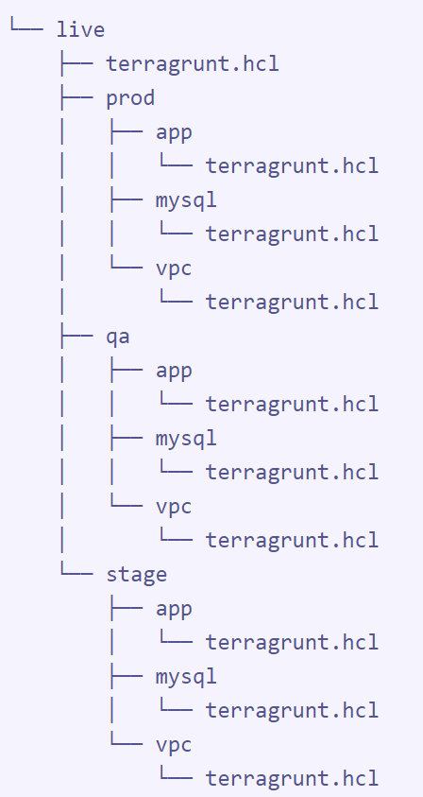
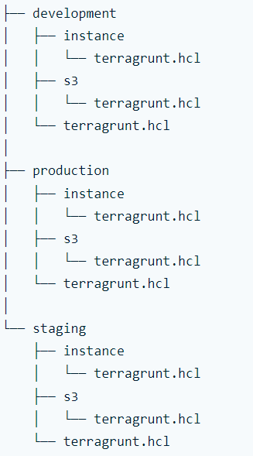
Deploy In Multiple Environments
Terragrunt is a thin wrapper that provides extra tools for keeping your configurations DRY, working with multiple Terraform modules, and managing remote state
You must turn all you configuration file int a module before using terragrunt
Pros of Terragrunt
It allows you to deploy in environment separately
It allows you to deploy in all environments recursively
Dependencies management

Slide 154
Deploy In Multiple Environments
terragrunt.hcl main file
remote_state {
backend = "s3"
generate = {
path = "backend.tf"
if_exists = "overwrite_terragrunt"
}
config = {
bucket = "ektec-development-student-terragrunt-state"
key = "${path_relative_to_include()}/terraform.tfstate"
region = "us-east-1"
encrypt = true
dynamodb_table = "ektec-development-student-terragrunt-state-lock"
}
}

Slide 155
Deploy In Multiple Environments
Terragrunt will automatically create a state file
# Generated by Terragrunt. Sig: nIlQXj57tbuaRZEa
terraform {
backend "s3" {
bucket = "ektec-development-student-terragrunt-state"
dynamodb_table = "ektec-development-student-terragrunt-state-lock"
encrypt = true
key = "./terraform.tfstate"
region = "us-east-1"
}
}

Slide 156
Deploy In Multiple Environments
terragrunt.hcl file for vpc for each environment
terraform {
source = "../../../modules/vpc"
}
include {
path = find_in_parent_folders()
}
inputs = {
vpc_cidr = "10.0.0.0/16"
vpc_name = "development-vpc"
aws_region = "us-east-1"
}

Slide 157
Deploy In Multiple Environments
terragrunt.hcl file for ec2 for each environment
terraform {
source = "../../../modules/ec2"
}
include {
path = find_in_parent_folders()
}
inputs = {
aws_region = "us-east-1"
instance_type = "t2.medium"
instance_ami = "ami-052efd3df9dad4825"
instance_name = "development-web-01"
}

Slide 158
Deploy In Multiple Environments
terragrunt.hcl file for s3 for each environment
terraform {
source = "../../../modules/s3"
}
include {
path = find_in_parent_folders()
}
inputs = {
aws_region = "us-east-1"
bucket_name = "development-test-0005"
}

Slide 159
Deploy In Multiple Environments
terraform {
source = "../../../terraform-library/rds-sg/"
}
dependencies {
paths = [
"${get_terragrunt_dir()}/../vpc",
"${get_terragrunt_dir()}/../bastion-sg",
"${get_terragrunt_dir()}/../web-sg"
]
}
# Include all settings from the root terragrunt.hcl file
include {
path = find_in_parent_folders()
}
inputs = {
aws_region = "us-east-1"
}
terragrunt.hcl file for rds for each environment with some dependencies

Slide 160
Terraform Projects

Slide 161
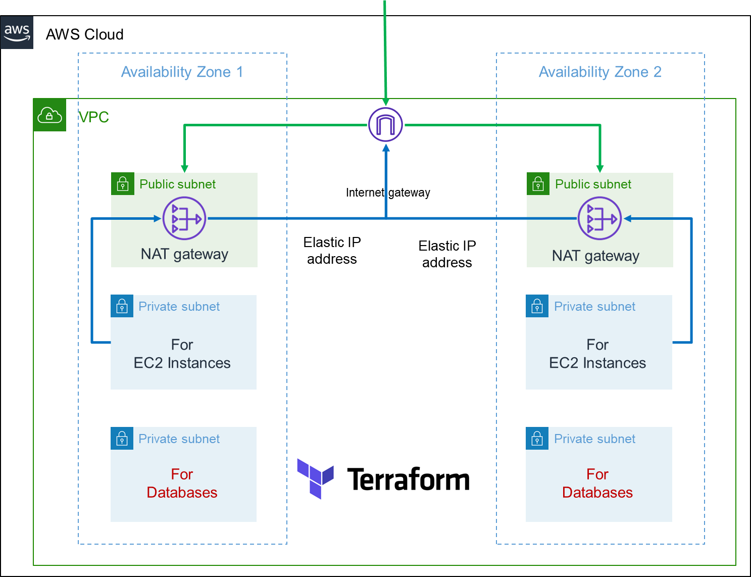
Terraform project
Create an AMI user for authentication through AWS API
Purchase a domain in route 53
Create an s3 bucket for Terraform state file
Create a DynamoDB table to lock the state file

Slide 162
Terraform project
Create a VPC with the following:
Public Subnets for load balancers, bastion host servers, and EKS control plane
Create private Subnets for the Database
Create private Subnets for Kubernetes nodes group

Slide 163

Terraform project
Create a bastion host server security group
Create a security group for web servers
Create a bastion host server in the public subnets
Create an EC2 in the private subnet and test if we can connect to it through through the bastion host in the public subnet

Slide 164
Terraform project
Create an ALB (application load balancer)
Create an ALB security
Create an ALB in the public Subnets
Create ALB target groups
Register EC2 as target groups

Slide 165
Terraform project
Create an ALB (application load balancer)
Create an SSL certificate and attach it to the load balancer
Create the ALB CNAME record in Route 53
Host a website in all EC2 behind the load balancer
Route HTTP traffic to HTTPS
Access the website through HTTPS on the browser

Slide 166
Terraform project
Create databases
Install MySQL and Postgres client on the bastion host
Create a security group for MySQL, Postgre, and aurora Postgres cluster

Slide 167
Terraform project
Create databases
Launch a MySQL database on the database’s private subnets and connect from the bastion host server using the endpoint
Store database passwords In in AWS parameters store or secret manager

Slide 168
Terraform project
Create databases
Launch a Postgres database on the database's private subnets and connect from the bastion host server using the endpoint
Store database passwords In in AWS parameters store or secret manager

Slide 169
Terraform project
Create databases
Launch an aurora Postgres cluster database on the database’s private subnets and connect from the bastion host server using the endpoint
Store database passwords In in AWS parameters store or secret manager

Slide 170
Terraform project
Create databases
Create MySQL database CNAME records in route 53 and connect from the bastion host server using the DNS

Slide 171
Terraform project
Create databases
Create Postgres database CNAME records in route 53 and connect from the bastion host server using the DNS

Slide 172
Terraform project
Create databases
Create aurora Postgres cluster database CNAME records in route 53 and connect from the bastion host server using the DNS

Slide 173

Review EKS Deployment Mode

Slide 174

Terraform project
Create EKS Control Plane
Discuss Kubernetes cluster creator
Create the assume role
Attach policies to the roles
Create a Kubernetes control plane in the public subnets

Slide 175
Terraform project
Create EKS Node group
Create the assume role
Attach policies to the roles

Slide 176
Terraform project
Create EKS Node group
Create a Kubernetes node group in the private subnet
Access the node group through the bastion host

Slide 177
Terraform project
Create EKS Node group
Create the aws-auth config with the null resources

Slide 178
Terraform project
Create EKS Node group
Create a Kubernetes node group in the public subnet
Access the node group through the bastion host

Slide 179
Terraform project
Create EKS Node group
Create a Kubernetes blue node group in the private subnet
Access the node group through the bastion host

Slide 180
Terraform project
Create EKS Node group
Create a Kubernetes green node group in the private subnet
Access the node group through the bastion host

Slide 181
Terraform project
Create EKS Node group
Implement a bleen green using conditions for EKS upgrade

Slide 182
Terraform project
Create EKS Node group
Implement a bleen green using conditions for EKS upgrade

Slide 183
Terraform project
Implement Kubernetes RBAC (role-based access control)
Create AWS admin full access users to EKS cluster without using role
Login through AWS console and check if you can see all kubernetes objects

Slide 184
Terraform project
Implement Kubernetes RBAC (role-based access control)
Create EKS admin full access to users EKS cluster without using role
Login through AWS console and check if you can see all kubernetes objects

Slide 185
Terraform project
Implement Kubernetes RBAC (role-based access control)
Create EKS read only access users to EKS cluster without using role
Login through AWS console and check if you can see all kubernetes objects

Slide 186
Terraform project
Implement Kubernetes RBAC (role-based access control)
Create AWS admin full access users to EKS cluster with assume role
Login through AWS console and check if you can see all kubernetes objects

Slide 187
Terraform project
Implement Kubernetes RBAC (role-based access control)
Create EKS admin full access to users EKS cluster with assume role
Login through AWS console and check if you can see all kubernetes objects

Slide 188
Terraform project
Implement Kubernetes RBAC (role-based access control)
Create EKS read only access users to EKS cluster with assume role
Login through AWS console and check if you can see all kubernetes objects

Slide 189
Terraform project
Implement oidc connect provider

Slide 190
Terraform project
Implement Kubernetes RBAC (role-based access control)
Create a cluster role for EKS read only users
Create a cluster role binding for EKS read only users

Slide 191
Terraform project
Implement Kubernetes RBAC (role-based access control)
Create the AWS configmag
With AWS EKS admin users
With AWS admin users
With AWS EKS read only admin users
Test RBAC implementation

Slide 192
Terraform project
Create AWS ECR
Create aws ECRs with for_each
Create a Dockerfile for out application
Build the Dockerfile and Push into AWS ECR

Slide 193
Terraform project
Create namespace
Create aws namespaces with for_each

Slide 194
Terraform project
Create EKS pods priority class

Slide 195
Terraform project
Create EBS CSI driver
Create a storage class

Slide 196
Terraform project
EKS Upgrade
Upgrade the EKS cluster from one version to another using the blue green mechanism
Patch the cordns
Patch the kube-proxy
Patch the VPC CNI
Flipp the node

Slide 197

Terraform Project
EKS Fargate Only
Create EKS Fargate Profile
Patch the fargate cordns (AWS fargate do not come with cordns like EKS nodes group)
Create Fargate nodes

Slide 198

Terraform Project
Create EKS With Fargate Profile

Slide 199

Terraform Project

Slide 200

Terraform Project

Slide 201
Terraform project
Decommission Kubernetes nodes from the cluster
1- Taint the node
2- Launch a new node and remove the old node from the autoscaling group
3- Drain the old node
4 - Terminate the old node

Slide 202
Terraform project
Metric Server
Create metric server policy and role
Install metric server chart in the cluster

Slide 203
Terraform project
Cluster Autoscaler
Create cluster autoscaler policy and role
Install cluster autoscaler chart in the cluster
Implement Kubernetes nodes autoscaling

Slide 204
Terraform project
External DNS
Create external DNS policy and role
Install External DNS Chart in the cluster

Slide 205
Terraform project
Load Balancer Controller
Create load balancer controller policy and role
Create load balancer controller ingress class
Install load balancer controller policy in the cluster

Slide 206

Terraform key features
Implement SSL with:
Application load balancer with path based routing
ALB ingress controller
Use external DNS to create record in route 53

Slide 207

AWS CLI Profile

